Slide 1




Unfolding the Atmospheric Muon Flux with IceCube Pascal Gutjahr for the IceCube Collaboration
Cosmic Ray physics with high-energy atmospheric muons
LPC Caen
September 17-19, 2025
Source: NASA

Slide 2
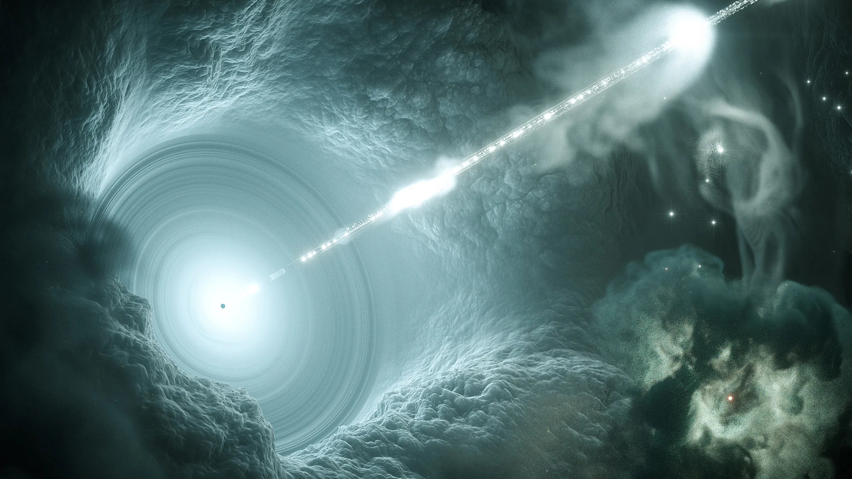

Slide 3

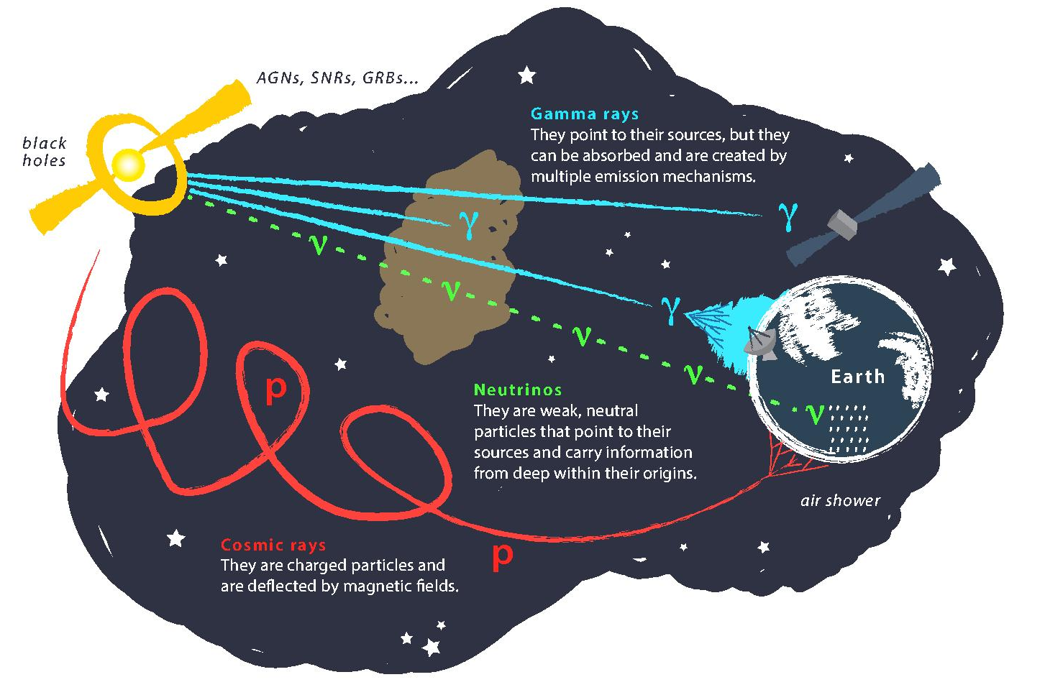
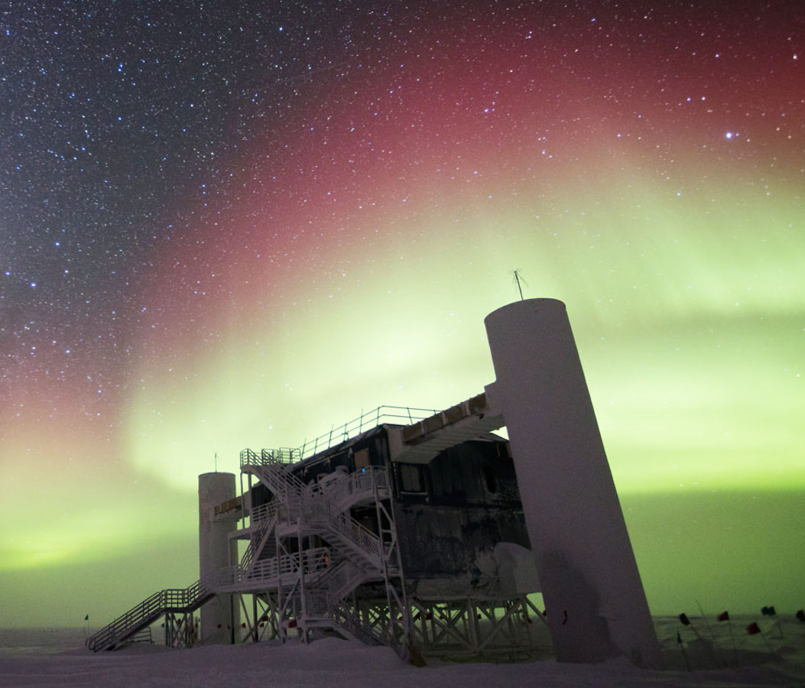
Astroparticle physics
Credit: IceCube / NSF
Source: gallery.icecube.wisc.edu

Slide 4
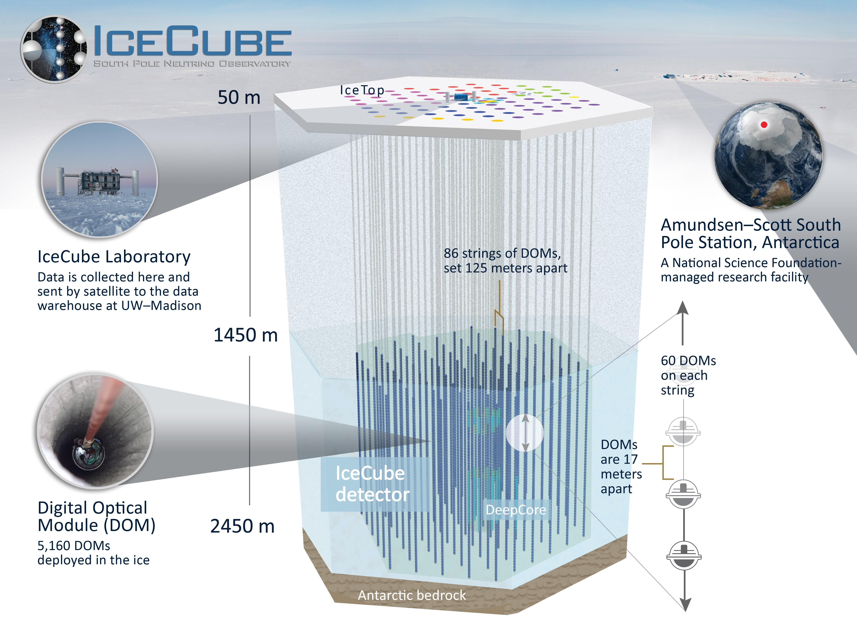
Credit: IceCube

Slide 5

Introduction
Motivation
Characterize muon flux components and depth intensity
Probe hadronic interactions in the atmosphere
Constrain uncertainties and longstanding questions like the “muon puzzle”
Long term
Enhance understanding of hadronic processes relevant in distant astrophysical sources (e.g., supernovae, AGNs, …)
$φ_{tot}=φ_{prompt}+$ $φ_{conventional}$
Conventional Muon:
Parent is pion or kaon
Credit: Ludwig Neste

Slide 6
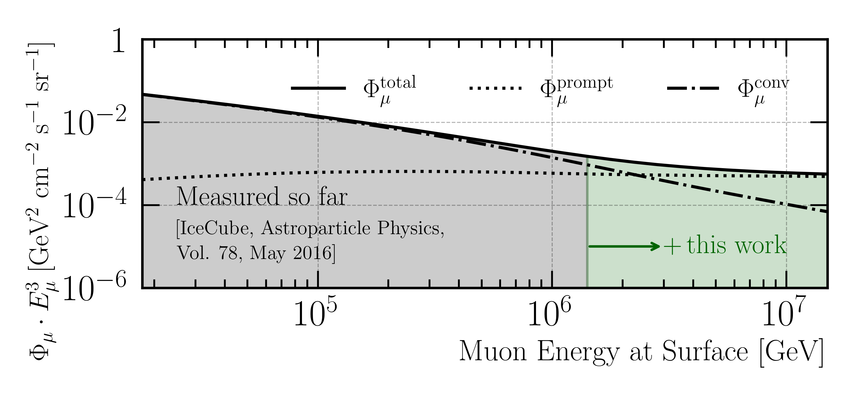
Goal: Measure Muon Flux at Surface
MCEq: SIBYLL 2.3d (H3a)

Slide 7
Overview
Simulation
Reconstruction
Selection
Unfolding
Dataset
CORSIKA 77500 Ehist
SIBYLL 2.3d
10 TeV – 100 EeV
DNN reconstructions
Muon energies
Muon direction
Track geometry
Level 3
L2 muon filter
500 TeV bundle energy cut at surface
Add labels
Muon spectrum
Unfold muon flux at surface
Validation
Tag prompt / conv particles
MCEq comparisons
Level 4
Add DNN reconstructions
Level 5
Data-MC quality cuts
Final Level
Leadingness cut

Slide 8
New CORSIKA simulation
with extended history option for information about the parent particles

Slide 9
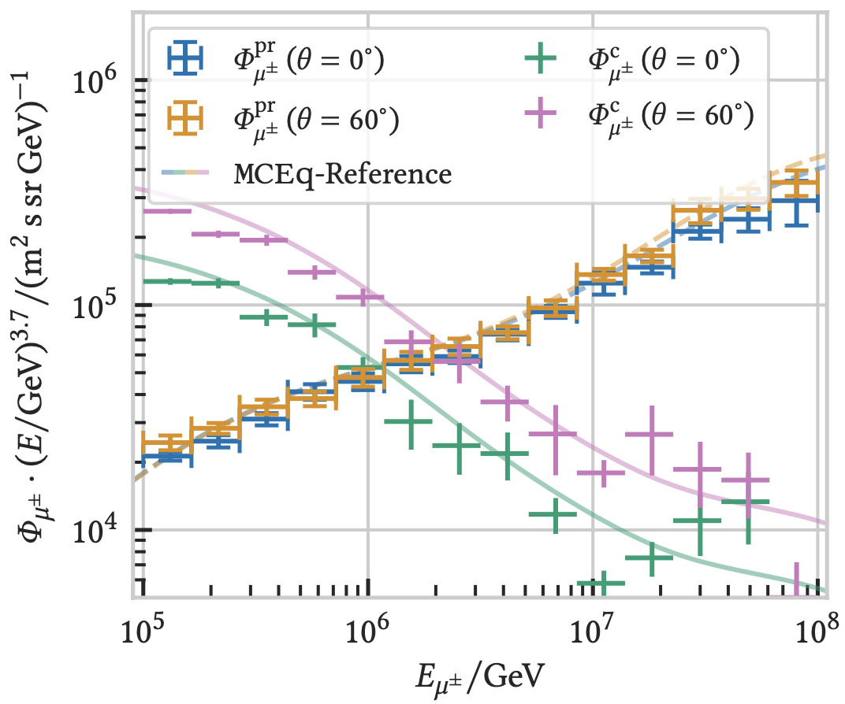

CORSIKA 7 vs. MCEq
MCEq: tool to numerically solve the cascade equations that describes the evolution of particle densities as they propagate through a gaseous, dense medium
https://github.com/mceq-project/MCEq
Good agreement for inclusive flux
Python package developed – PANAMA
Execute CORSIKA 7 (multi core)
Read DAT files → pandas DataFrames
Parse EHIST option
Calculate primary weightings
https://github.com/The-Ludwig/PANAMA
Neste & Gutjahr et al., EPJ C, 85, 759 (2025)

Slide 10
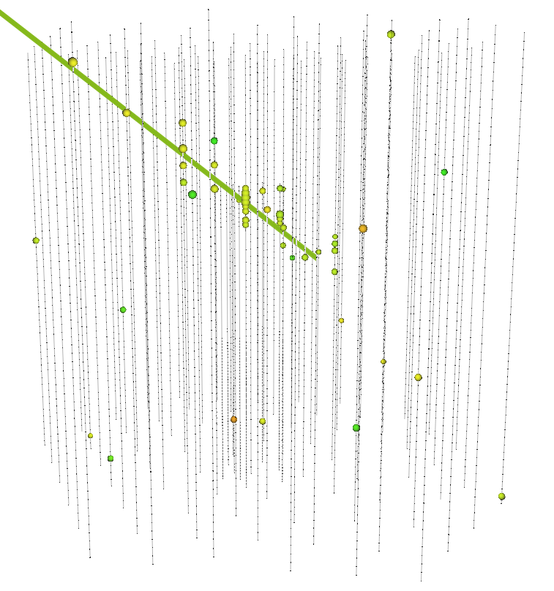
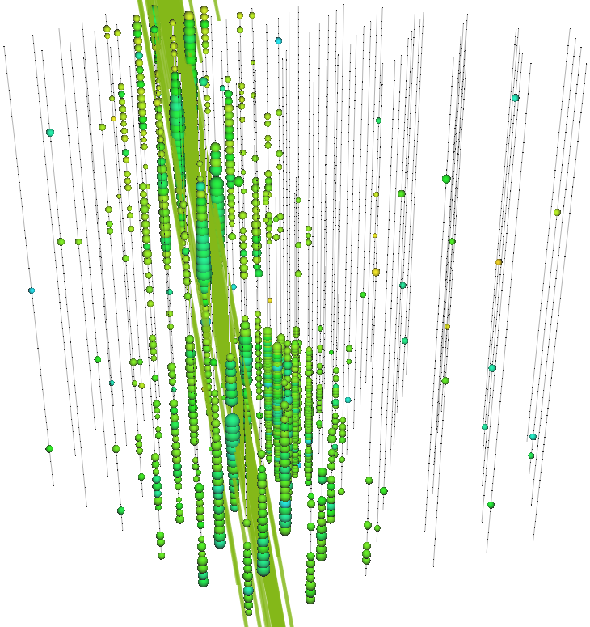
Stopping and Leading Muons
Leading muons:
Most energetic muon in the bundle
High energies above 10 TeV
Focus on muons carrying > 40% of the entire bundle
Stopping muons:
Stop (decay) inside the in-ice array
Stopping point + direction → propagated length
Proxy to muon energy at the surface
Low-energy muons

Slide 11
Reconstruction
Machine Learning (CNN)

Slide 12
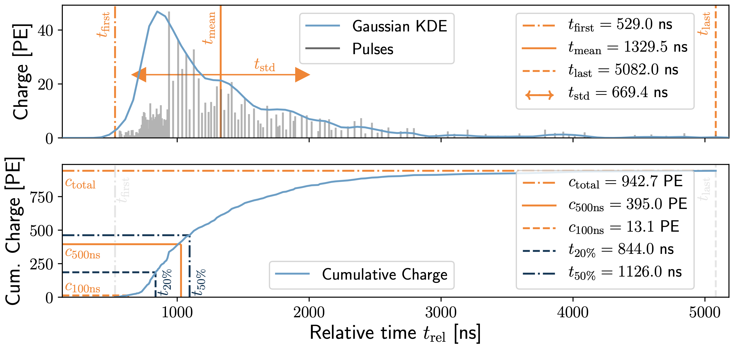
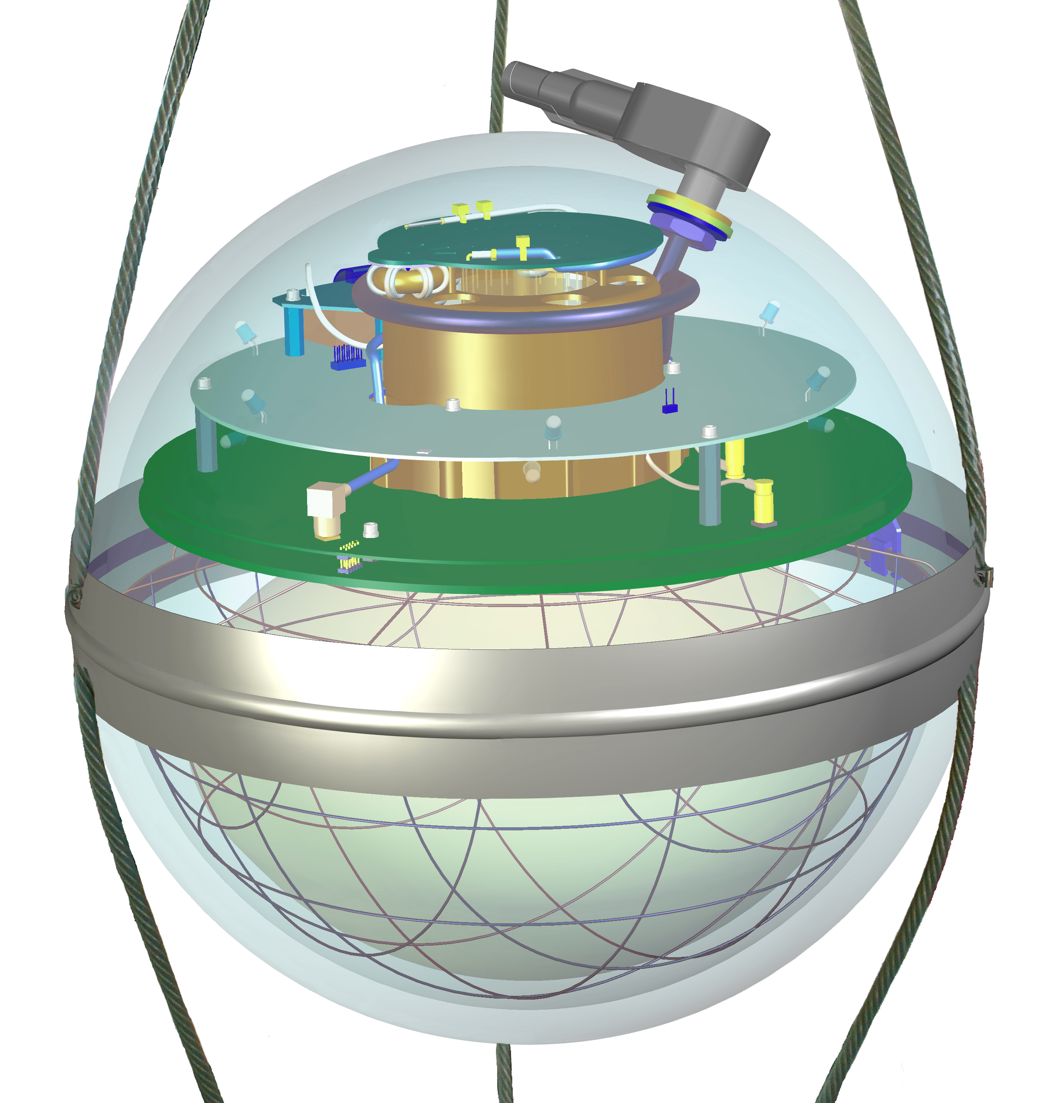
Input data per DOM
10.1088/1748-0221/16/07/P07041
3 inputs
c_{total}: Total charge
Sum of charge
t_{first}: Relative time of first pulse
Relative to total time offset, calculated as the charge weighted mean time of all pulses
t_{std}: Standard deviation of first pulse
Charge weighted standard deviation of pulse times relative to total time offset
9 inputs
t_{last}: Relative time of last pulse
Relative to total time offset, calculated as the charge weighted mean time of all pulses
t_{20%}: Relative time of 20% charge
Relative to total time offset, calculated as the charge weighted mean time of all pulses
t_{50%}: Relative time of 50% charge
Relative to total time offset, calculated as the charge weighted mean time of all pulses
t_{mean}: Mean time
Charge weighted mean time of all pulses relative to total time offset
c_{500ns}: Charge at 500ns
Sum of charge after 500ns
c_{100ns}: Charge at 100ns
Sum of charge after 100ns
Input pulse cleaning
6000 ns
Training data
Different simulations for robustness
Credit: IceCube

Slide 13
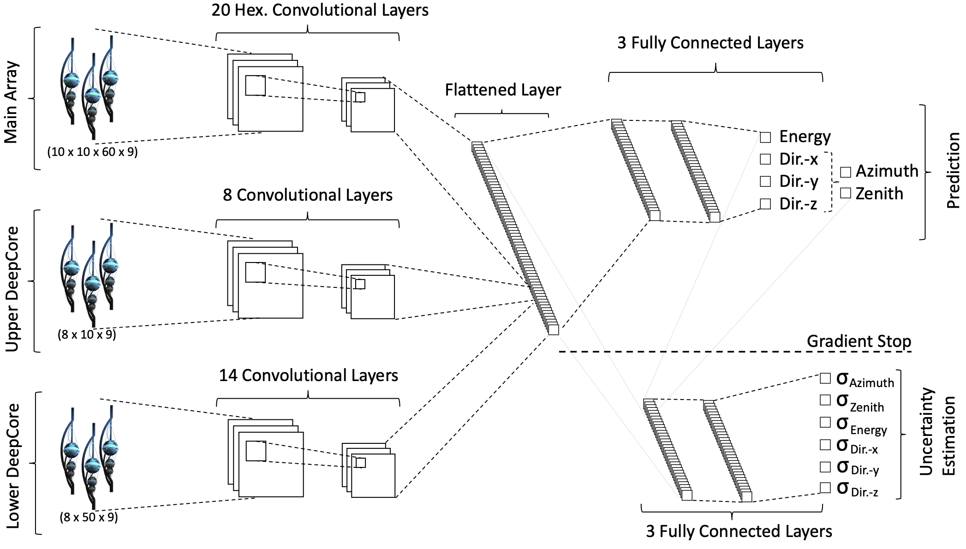
Convolutional Neural Network (CNN)
Machine learning approach:
fast
identifying spatial patterns
better event reconstruction and classification
2101.11589

Slide 14
Reconstructed properties
Energy
entry_energy: Leading muon energy at the detector entry
bundle_energy_at_entry: Muon bundle energy at the detector entry
muon_energy_first_mctree: Leading muon energy at surface
bundle_energy_in_mctree: Muon bundle energy at surface
Track geometry
Length: Propagation length of muon in the ice
LengthInDetector: Propagation length of muon in the detector
center_pos_x: Closest x position of muon to center of the detector
center_pos_y: Closest y position of muon to center of the detector
center_pos_z: Closest z position of muon to center of the detector
center_pos_t: Time of closest approach to the center of the detector
entry_pos_x: x position of muon at the detector entry
entry_pos_y: y position of muon at the detector entry
entry_pos_z: z position of muon at the detector entry
entry_pos_t: Time of muon at the detector entry
Direction
zenith: Zenith angle of muon
azimuth: Azimuth angle of muon
Network 1
Network 0: Muon bundle energy at surface (fast pre-cut)
Network 2
Network 3

Slide 15
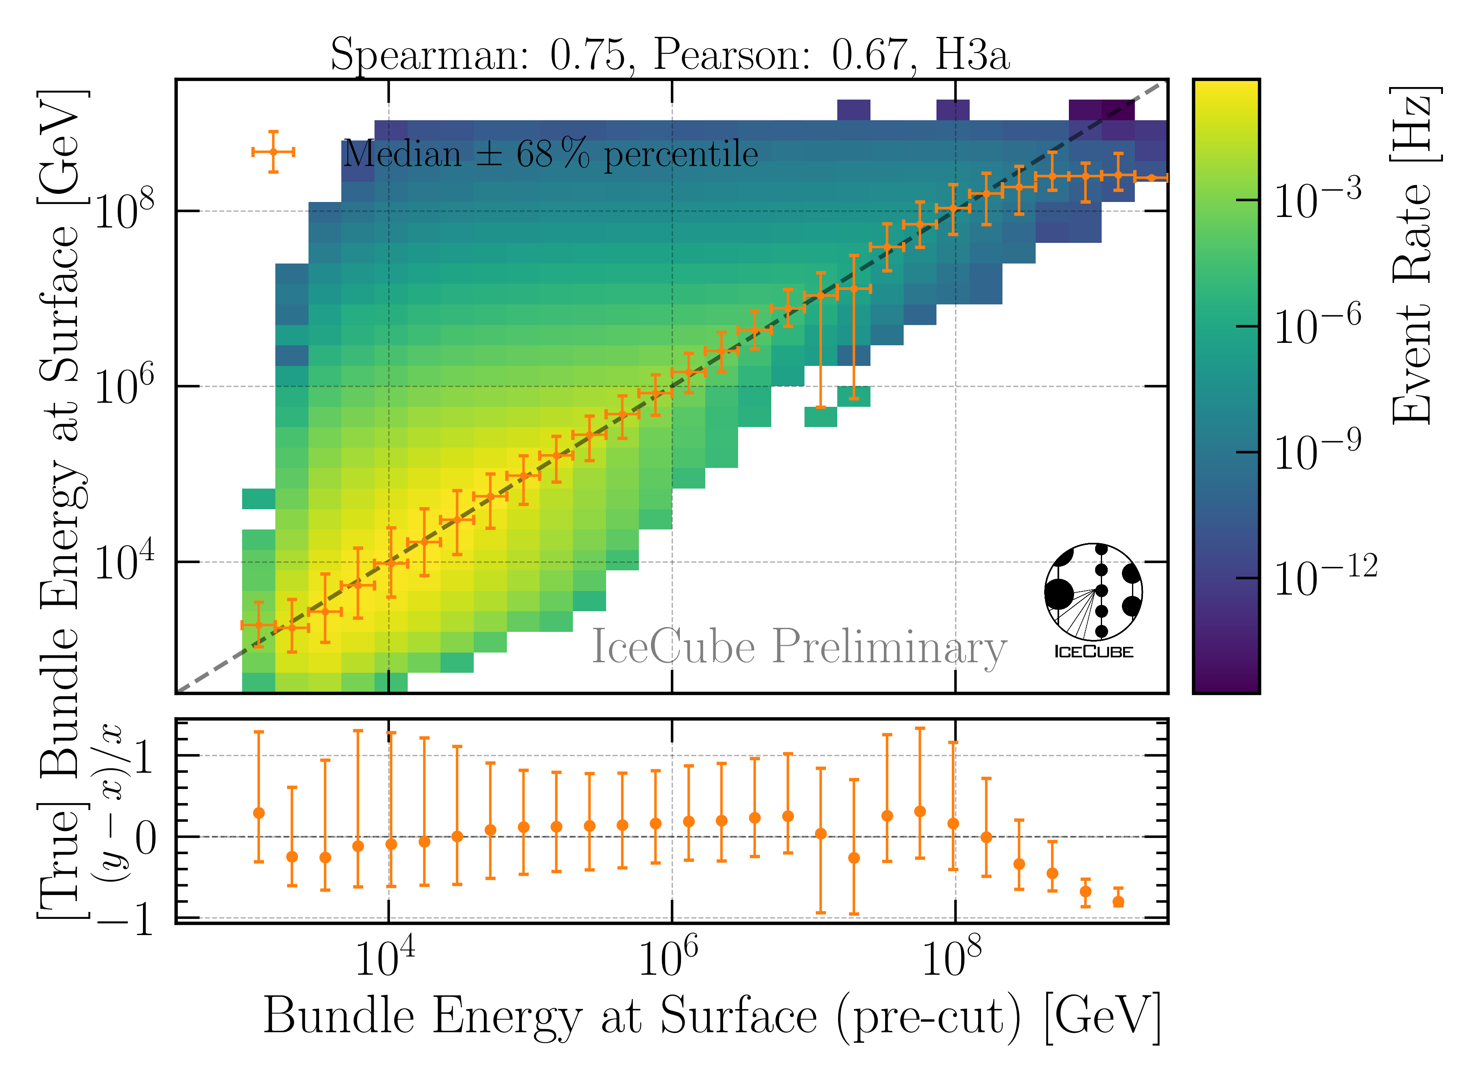
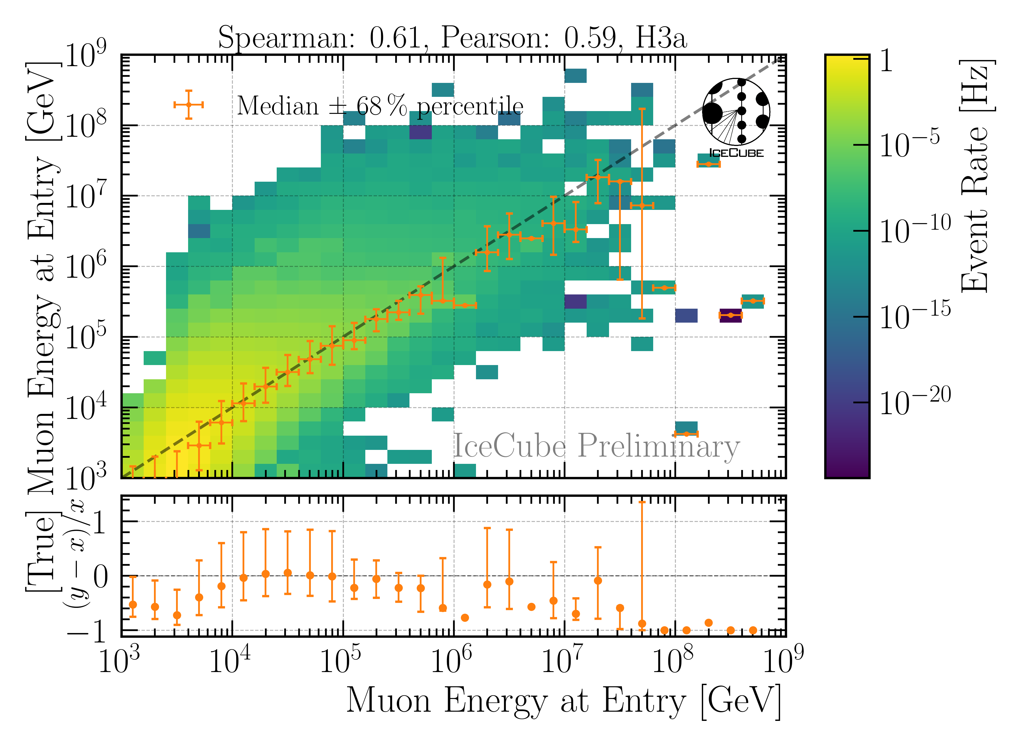
Energy Reconstructions
performed on Level 3 (explained later)
Sufficient energy reconstructions
Tight 68 % intervals, with outliers

Slide 16
Selection

Slide 17
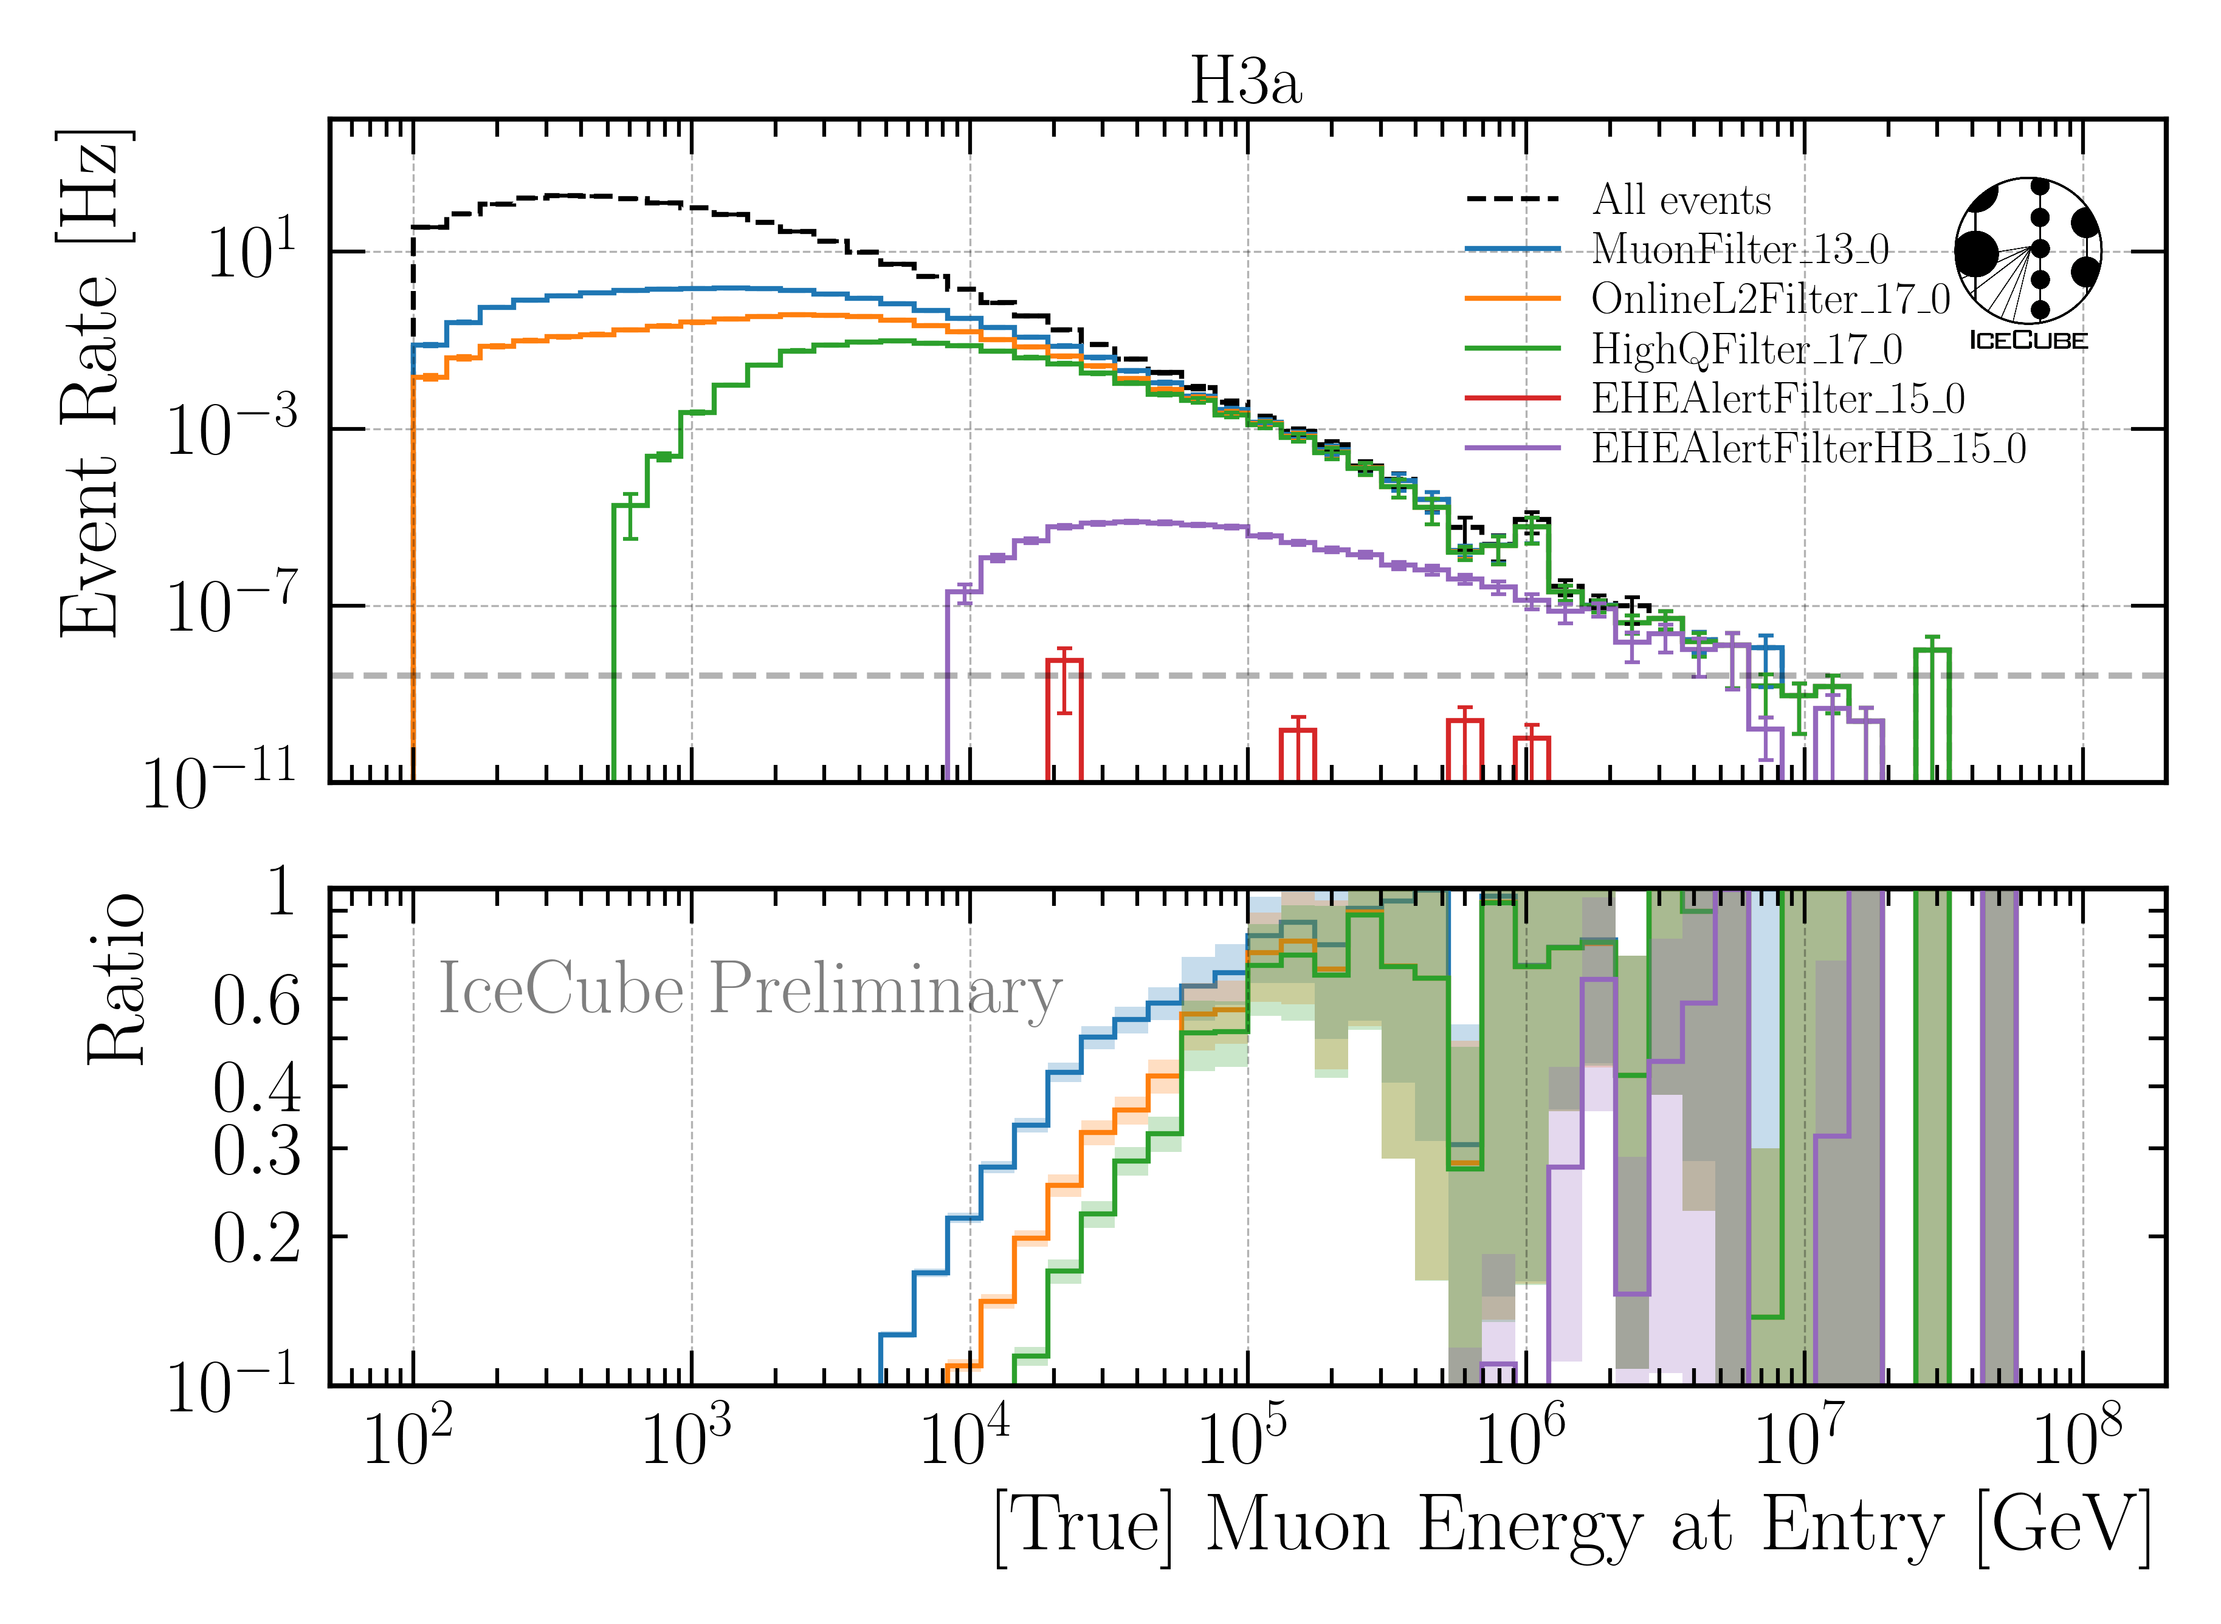
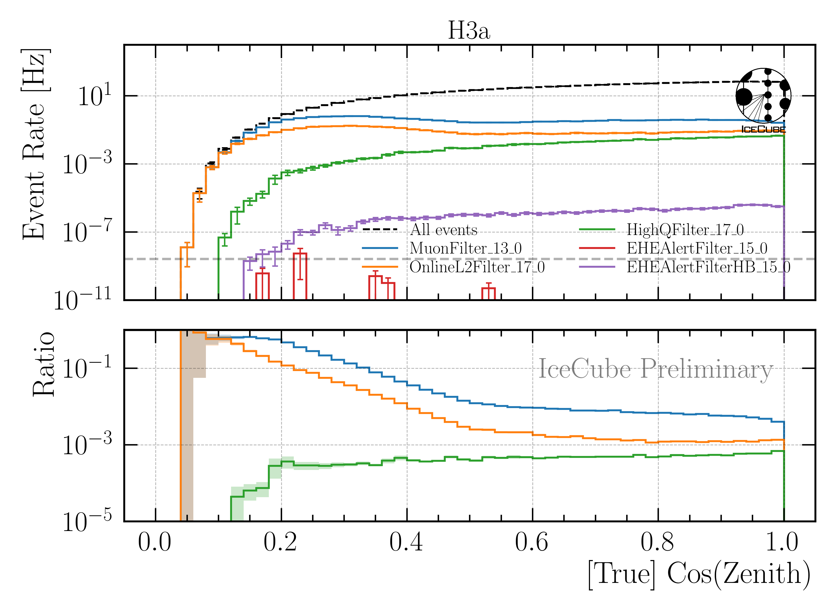
Level 3: Muon Filter
Muon filter: zenith-dependent charge and quality cut
Choose muon filter to select as many high-energy muons as possible

Slide 18
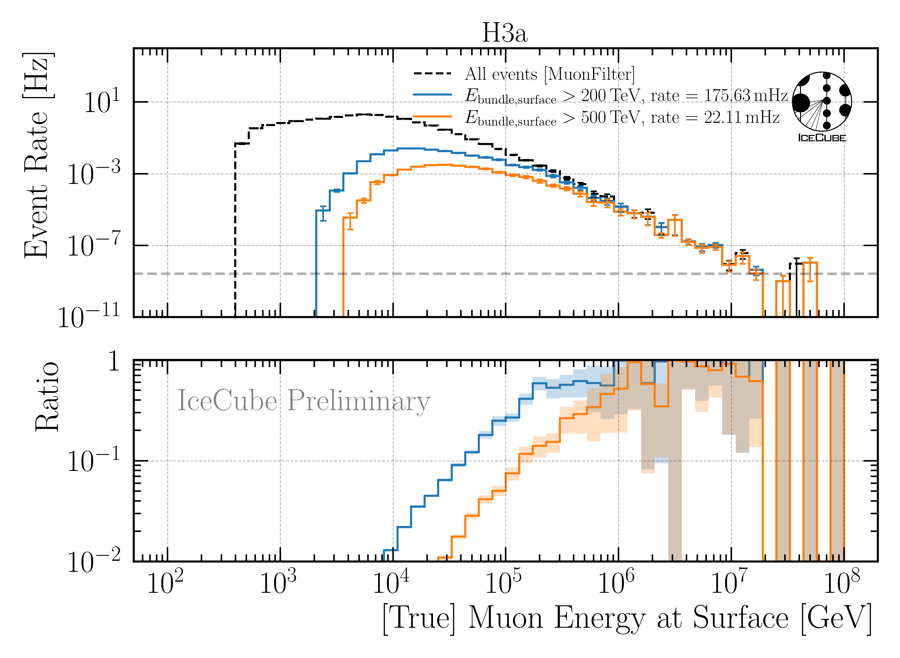
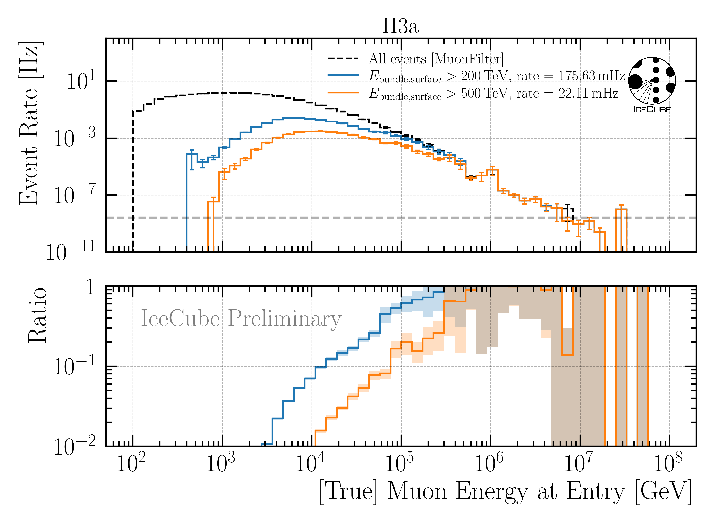
Level 4: Energy Cut
6 billion events expected in 10 years → computationally not feasible
focus on high-energetic events
Remove low-energy muons: bundle energy at surface > 500 TeV

Slide 19
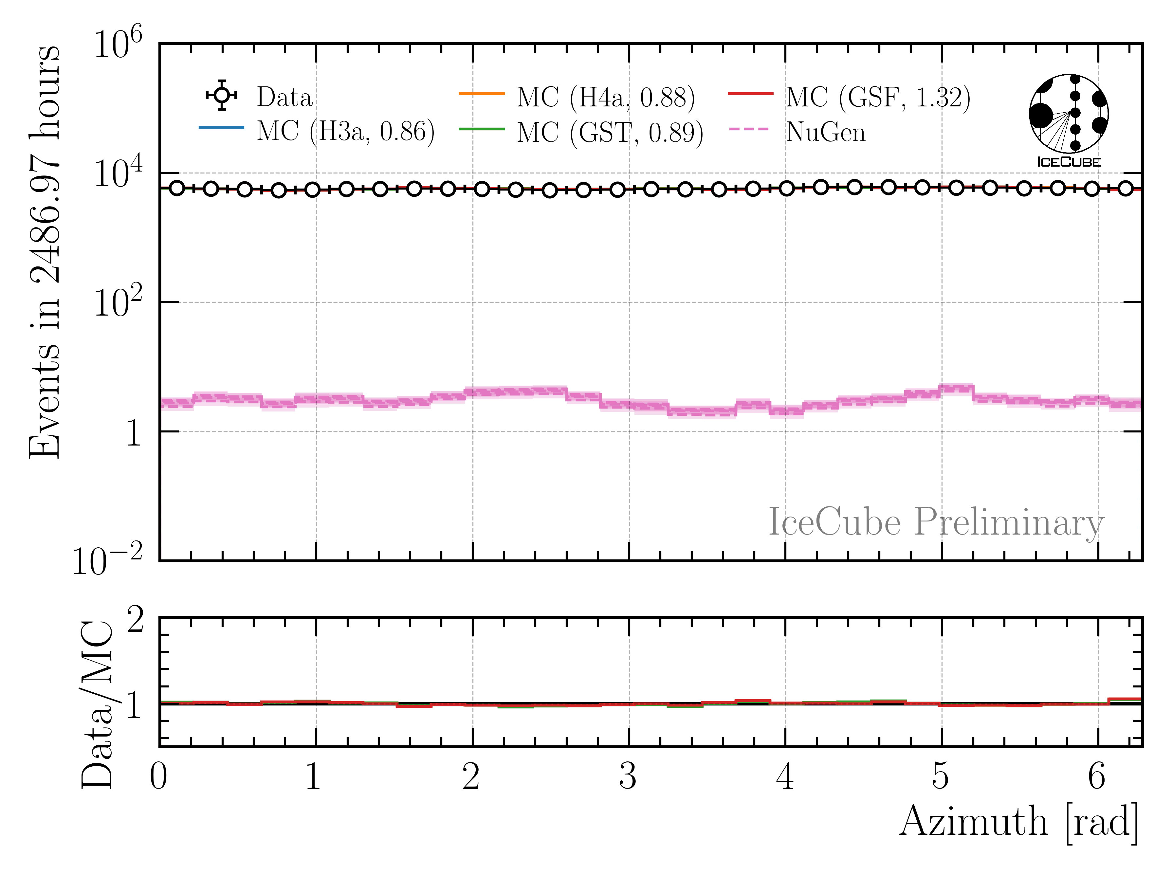
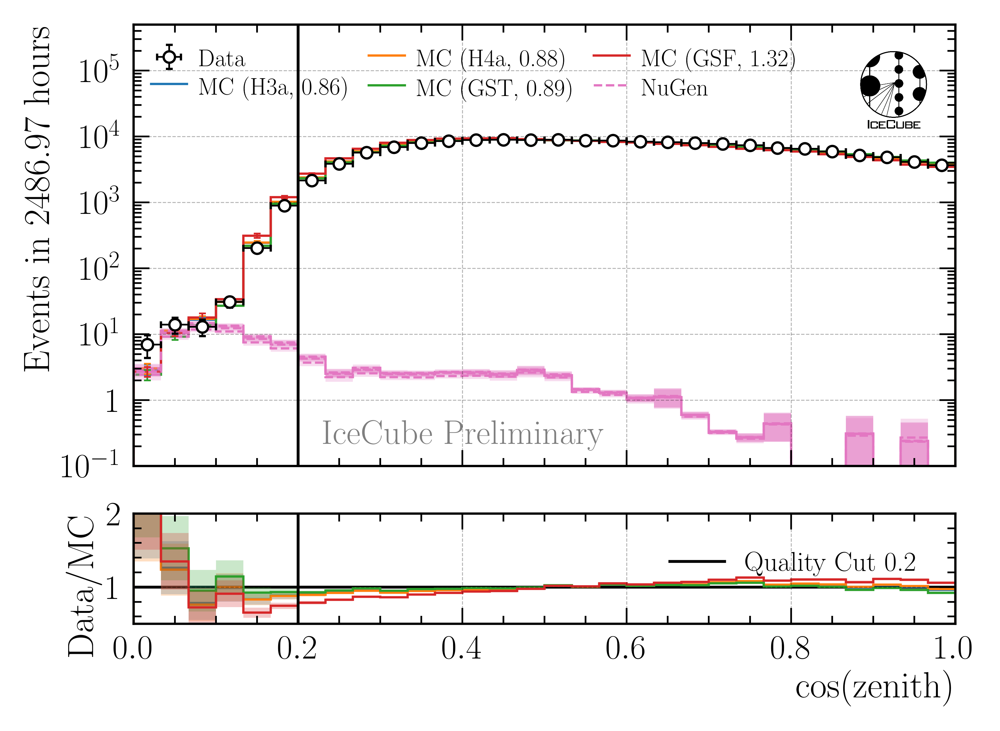
Level 5: Data/MC Quality Cuts
Neutrino weighting:
SPL: n = 1.8, 𝛾 = 2.52
IceCube Collaboration PoS ICRC2023 1064
Good directional reconstruction
Cut: cos(zenith) > 0.2

Slide 20
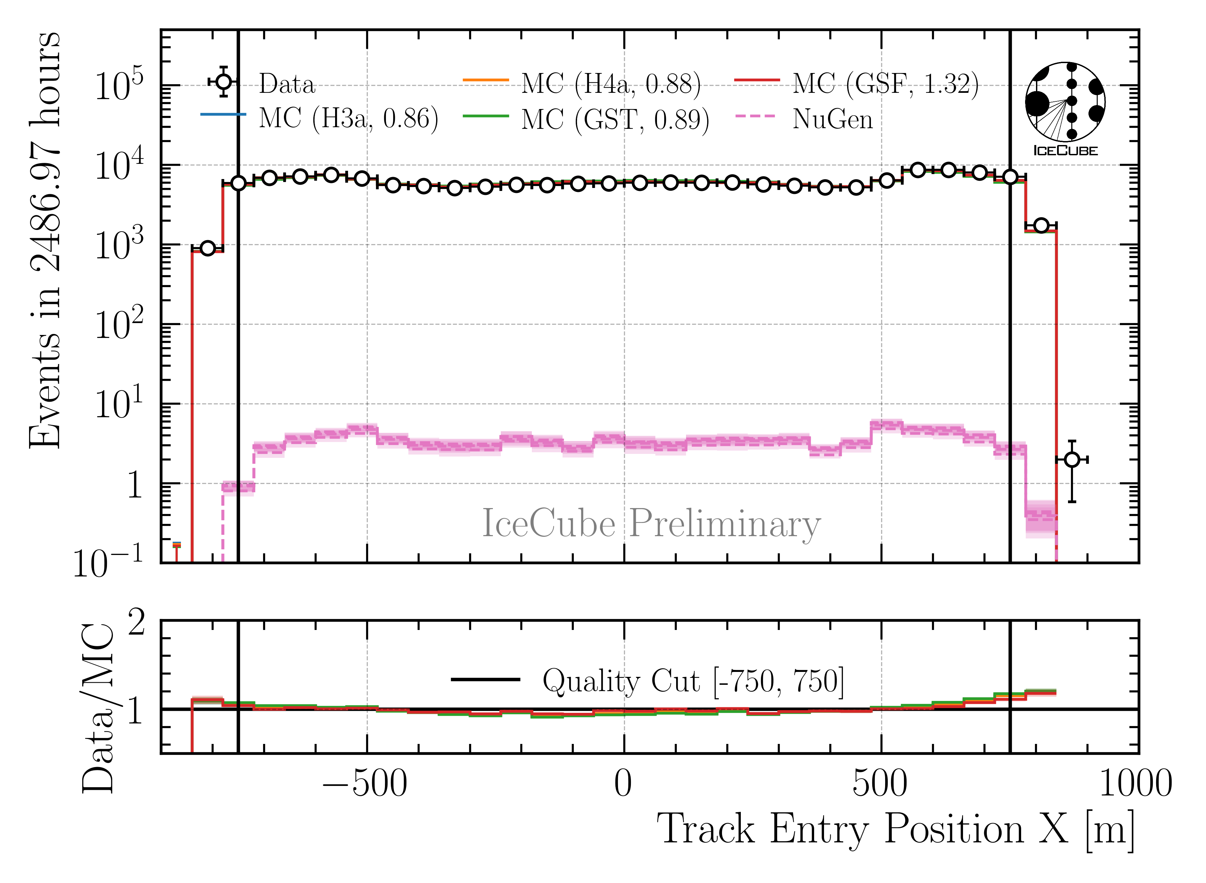
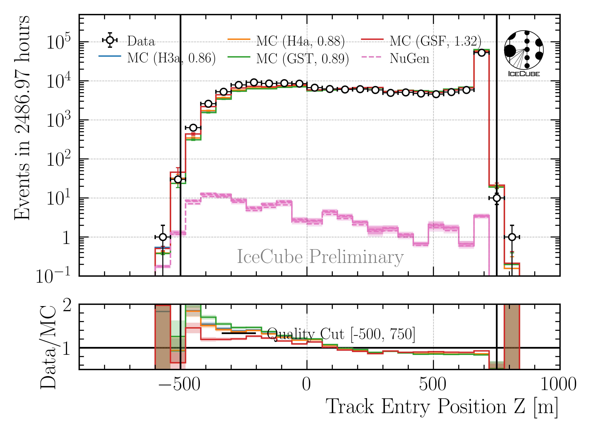
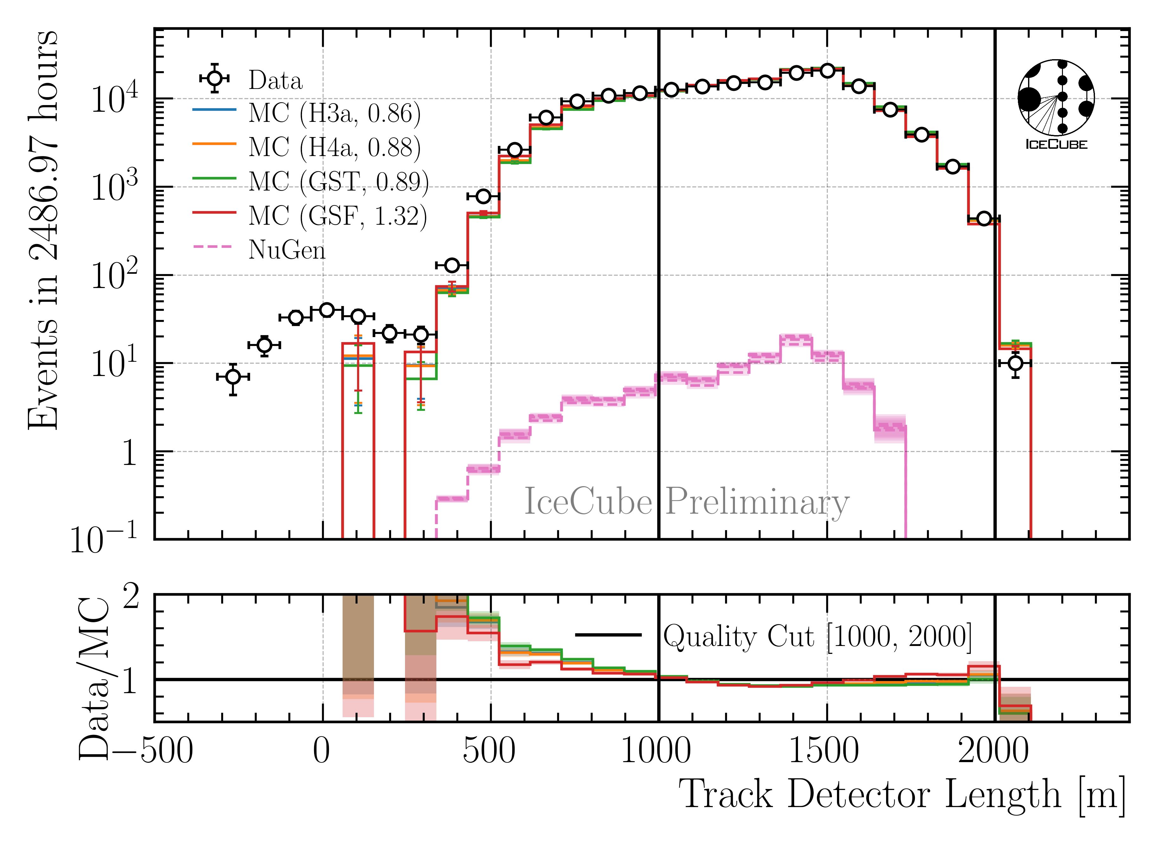
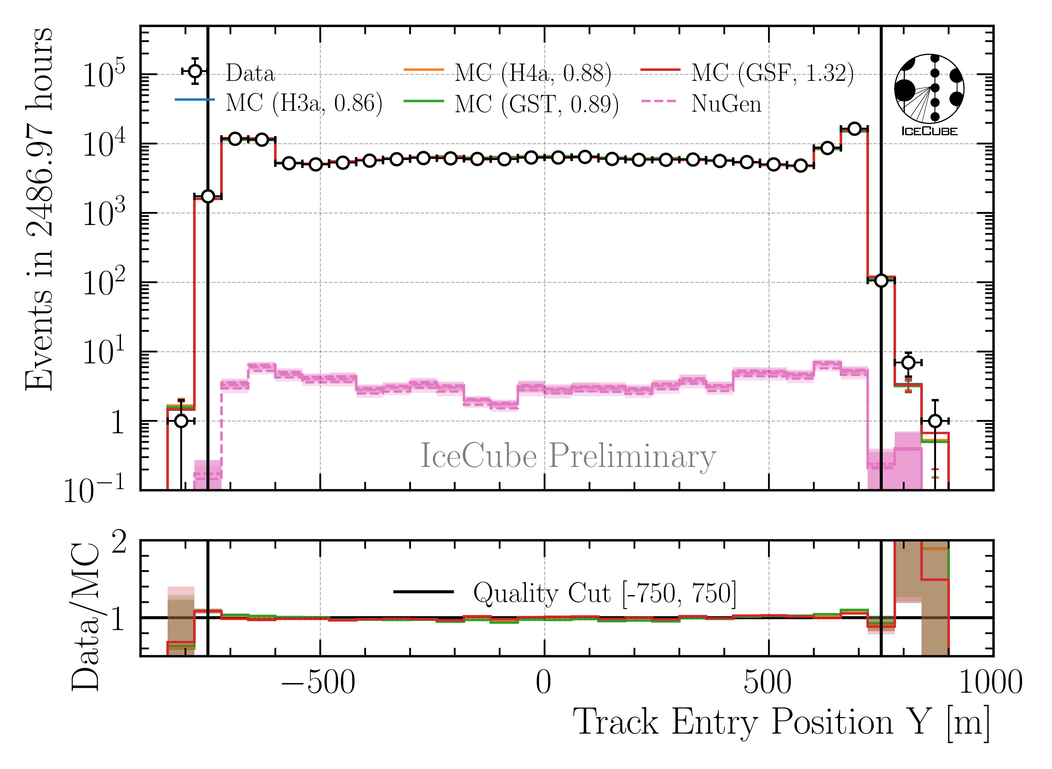
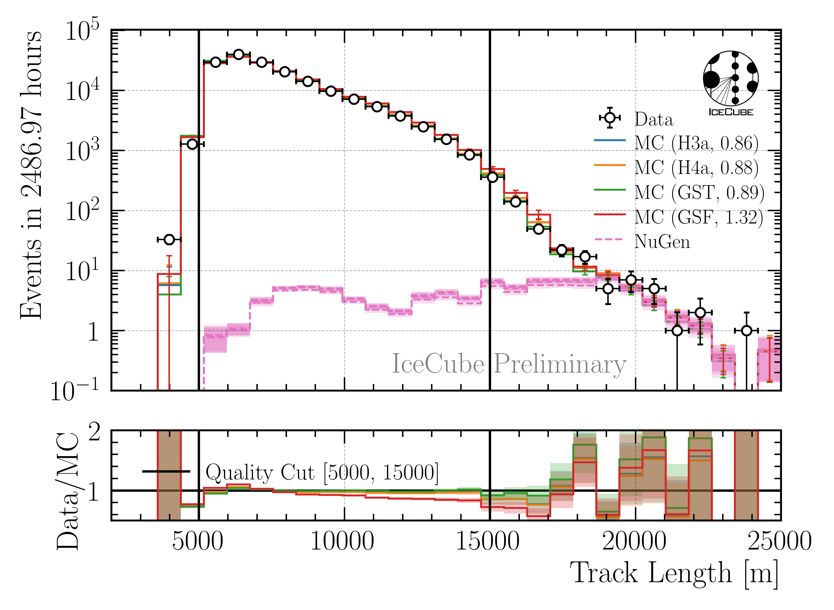
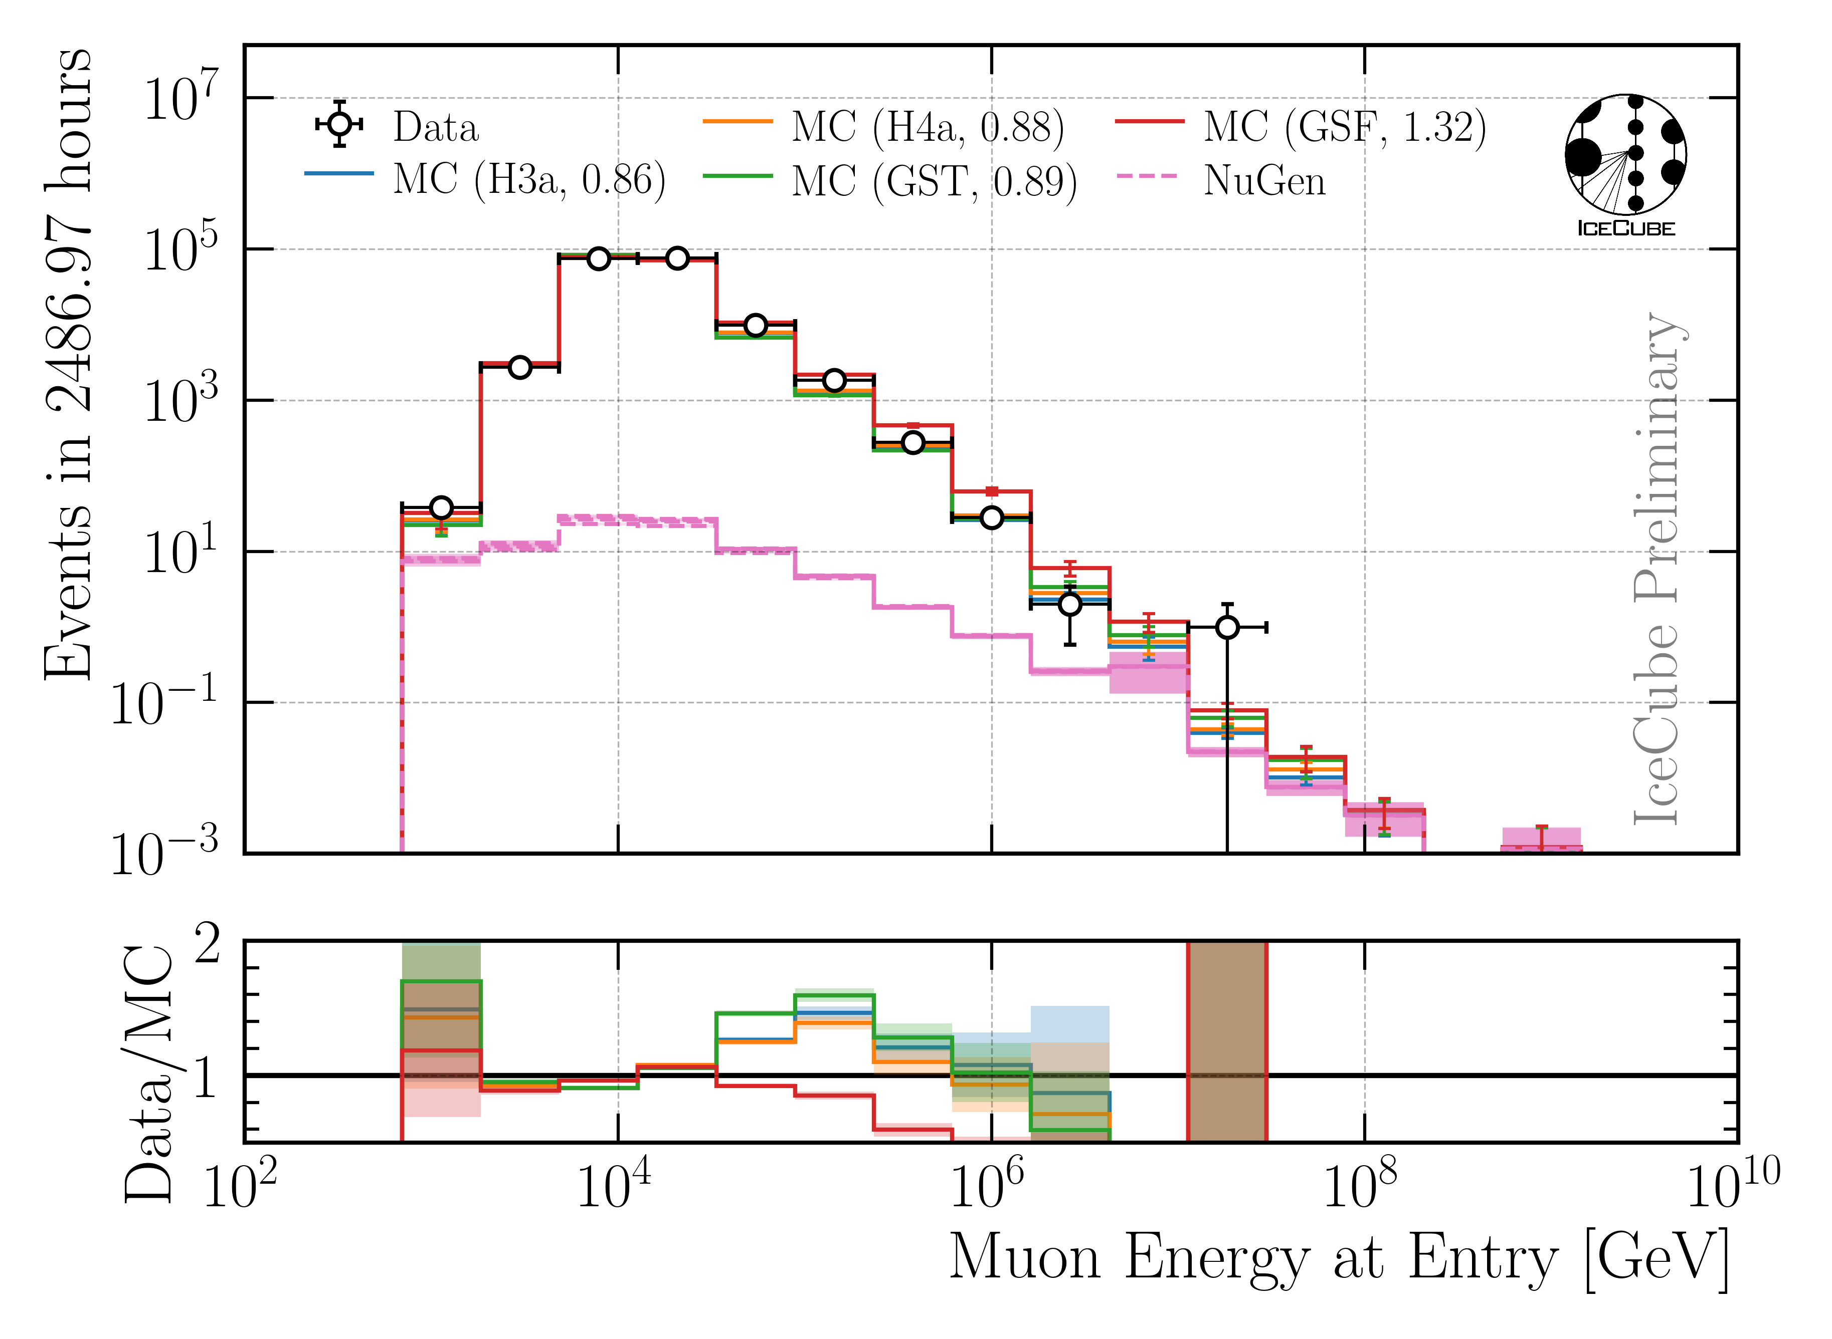
Level 5: Data/MC Quality Cuts
Remove outliers
Depth—dependent slope (no analysis relevance)
CR—model impact on energy reconstruction
23 quality cuts in total

Slide 21
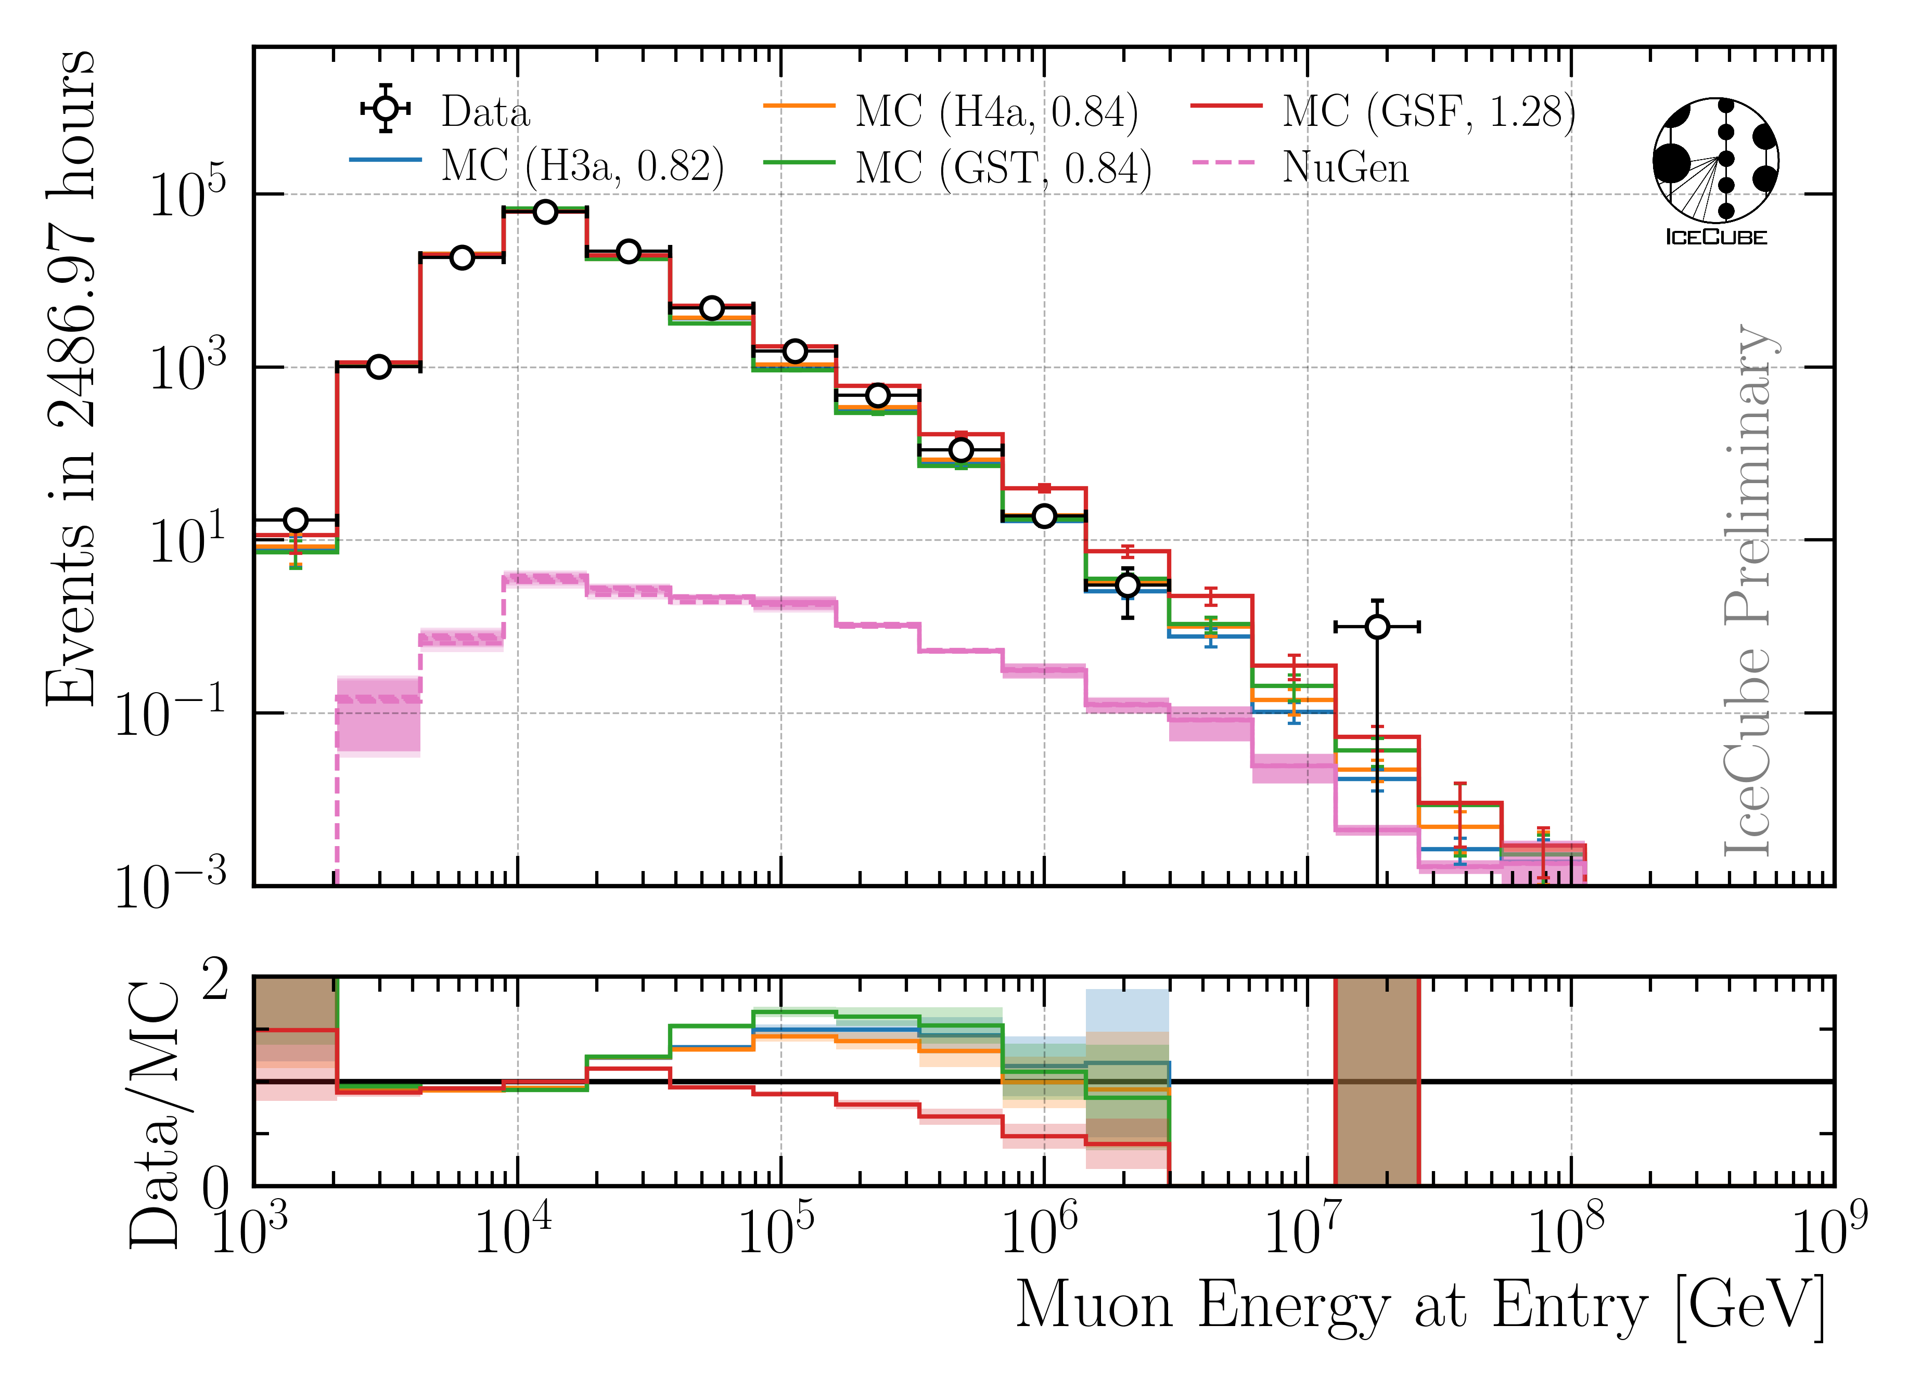
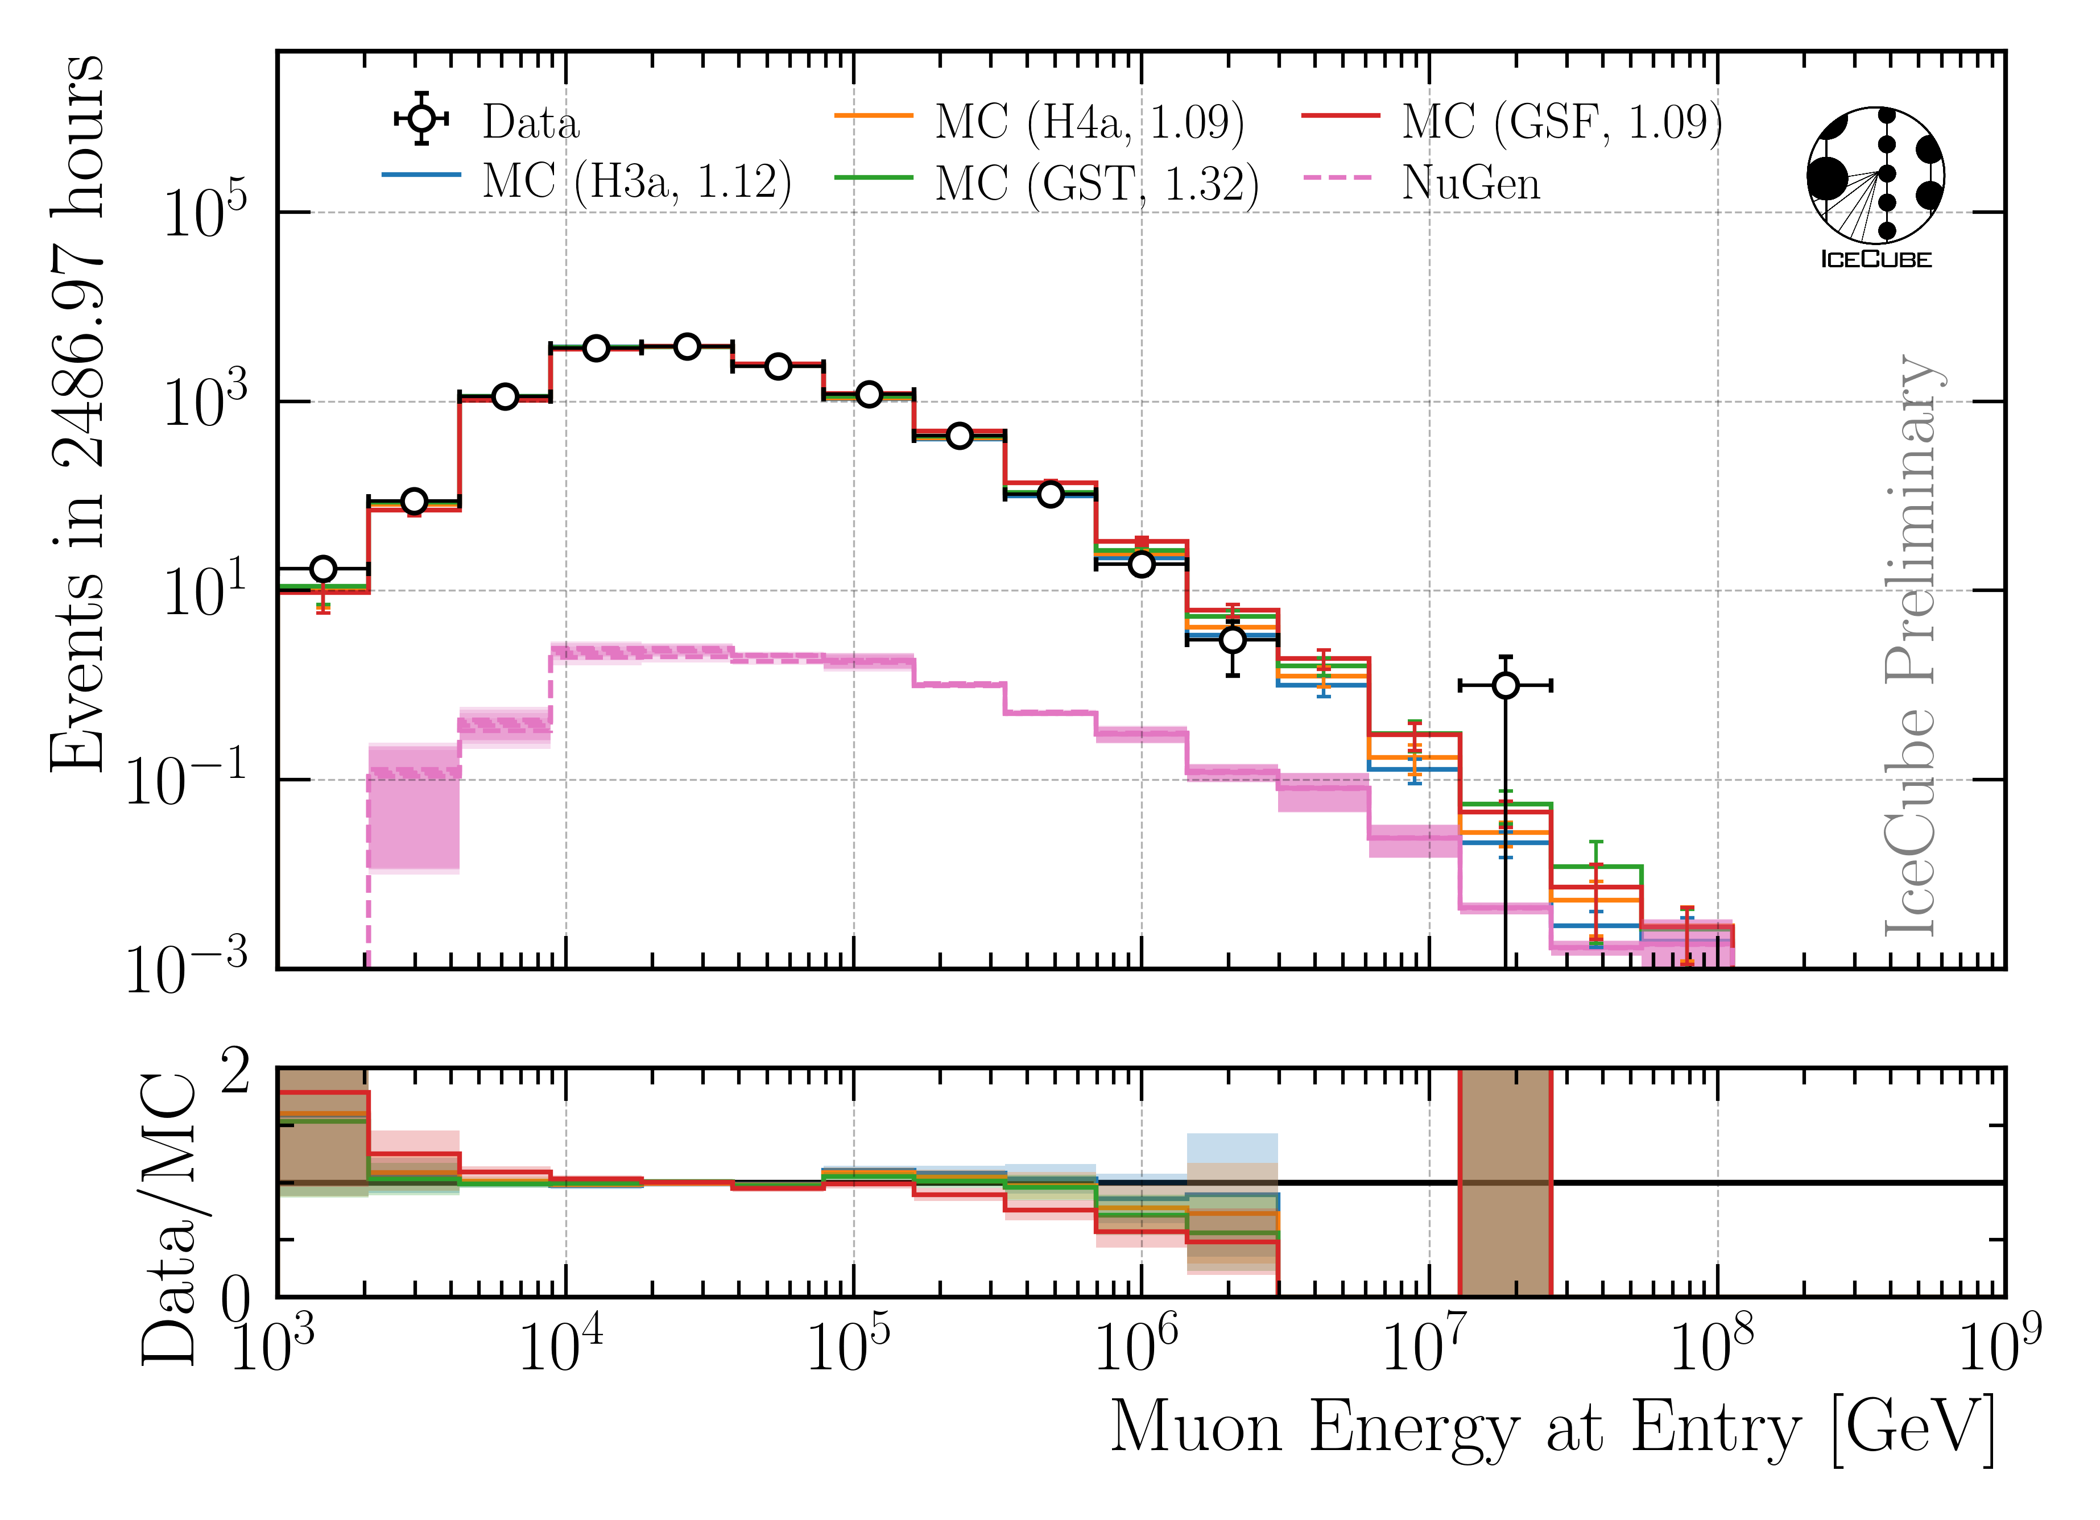
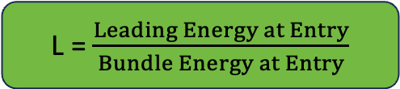
Final Level: Leadingness > 40 %
L = $\frac{Leading Energy at Entry}{Bundle Energy at Entry}$
No leadingness cut
Leadingness > 40 %
Improve Data/MC by leadingness cut

Slide 22
Unfolding

Slide 23
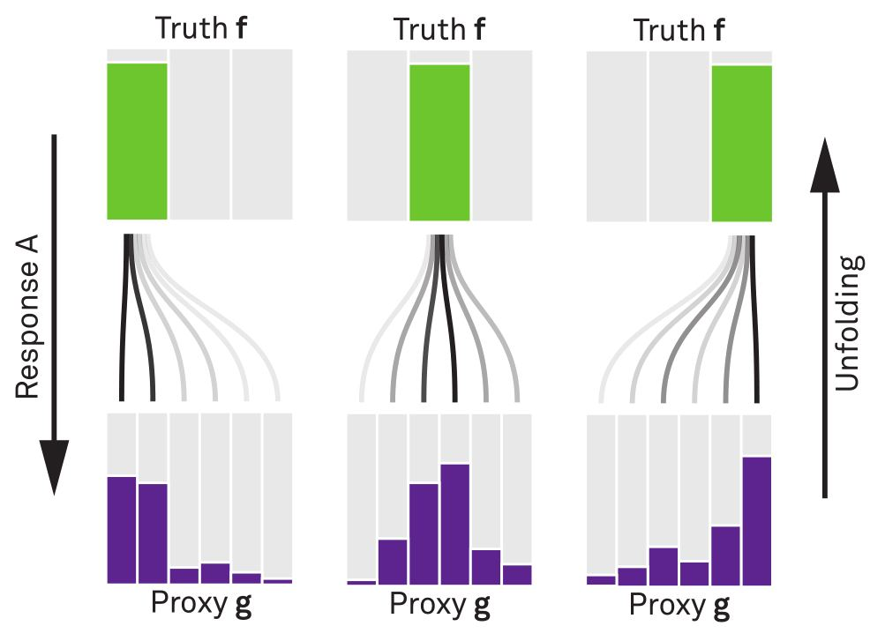


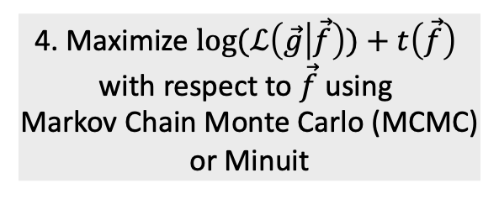
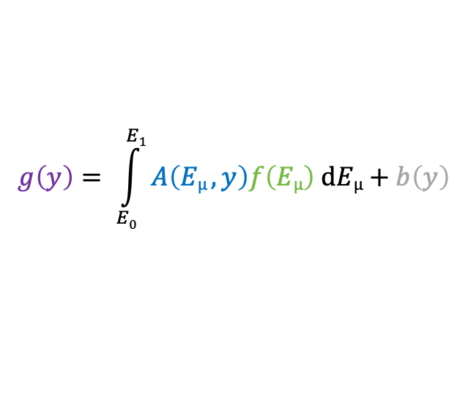
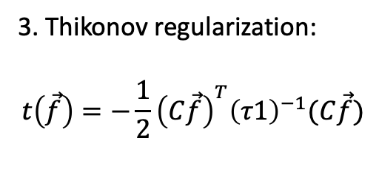
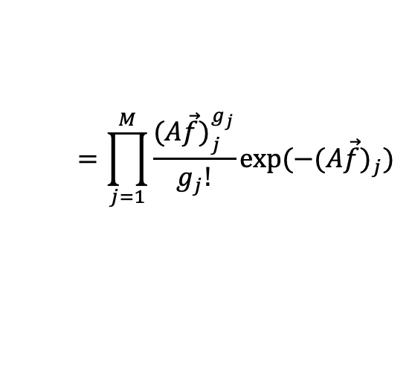
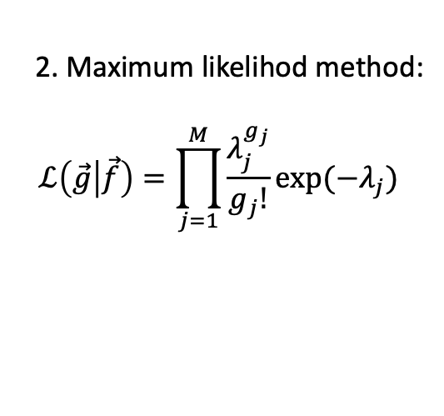
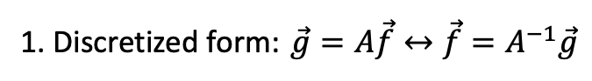
Unfolding in a nutshell
folding
unfolding
detector response
1. Discretized form: $\vec{g}=A\vec{f}↔\vec{f}=A^{−1}\vec{g}$
measured proxy
background
$$g\left(y\right)= \int_{E0}^{E1}{A\left(Eµ , y\right)f\left(Eµ\right) dEµ+b\left(y\right) }$$
2. Maximum likelihod method:
$$ℒ\left(\vec{g} | \vec{f}\right)=\prod_{j=1}^{M}{\frac{λ_{j}^{g_{j}}}{g_{j}!}exp⁡(−λ_{j})}$$
3. Thikonov regularization:
$$t\left(\vec{f}\right)=−\frac{1}{2}{\left(C\vec{f}\right)}^{T}{\left(τ1\right)}^{−1}(C\vec{f})$$
true energy distribution
$$=\prod_{j=1}^{M}{\frac{{(A\vec{f})}_{j}^{g_{j}}}{g_{j}!}exp⁡(−{(A\vec{f})}_{j})}$$
funfolding
by M. Börner
4. Maximize $log⁡(ℒ\left(\vec{g} | \vec{f}\right))+t\left(\vec{f}\right)$
with respect to $\vec{f}$ using
Markov Chain Monte Carlo (MCMC)
or Minuit
Credit: T. Hoinka

Slide 24
Muon Flux Unfolding
Effective area
Systematics
Proxy that correlates with target
Regularization
Unfolding

Slide 25
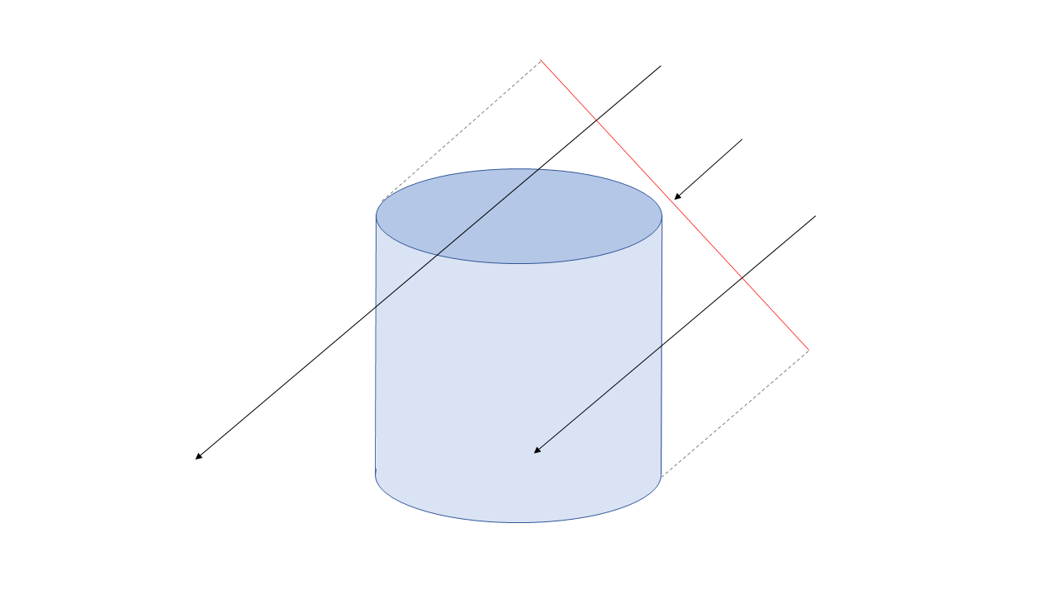
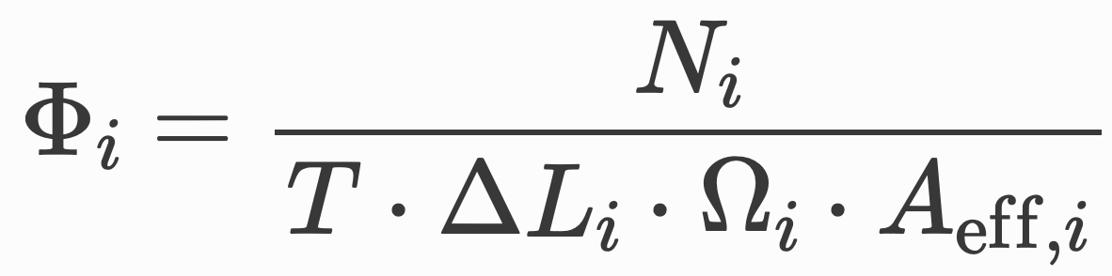
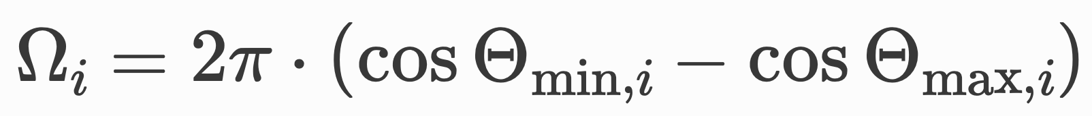
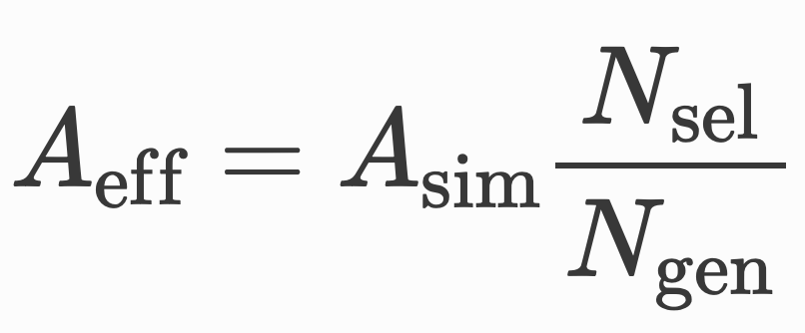
Event Rate to Flux → Effective Area
Unfolding estimates an event rate
Transfer event rate to flux
with solid angle
and effective area

Slide 26
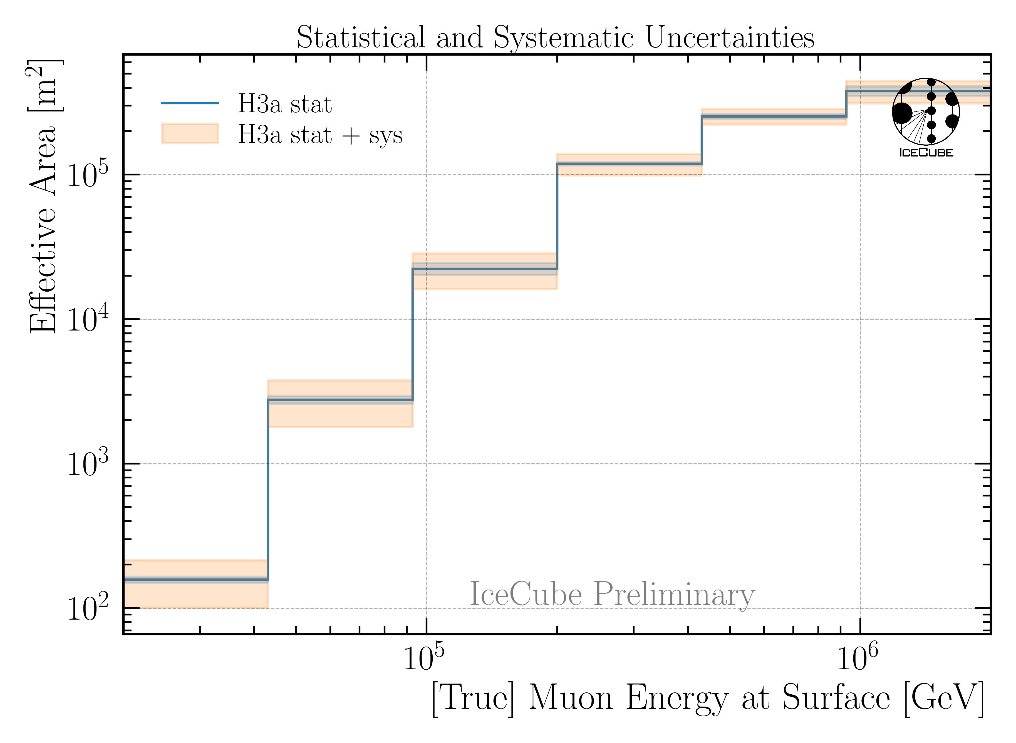
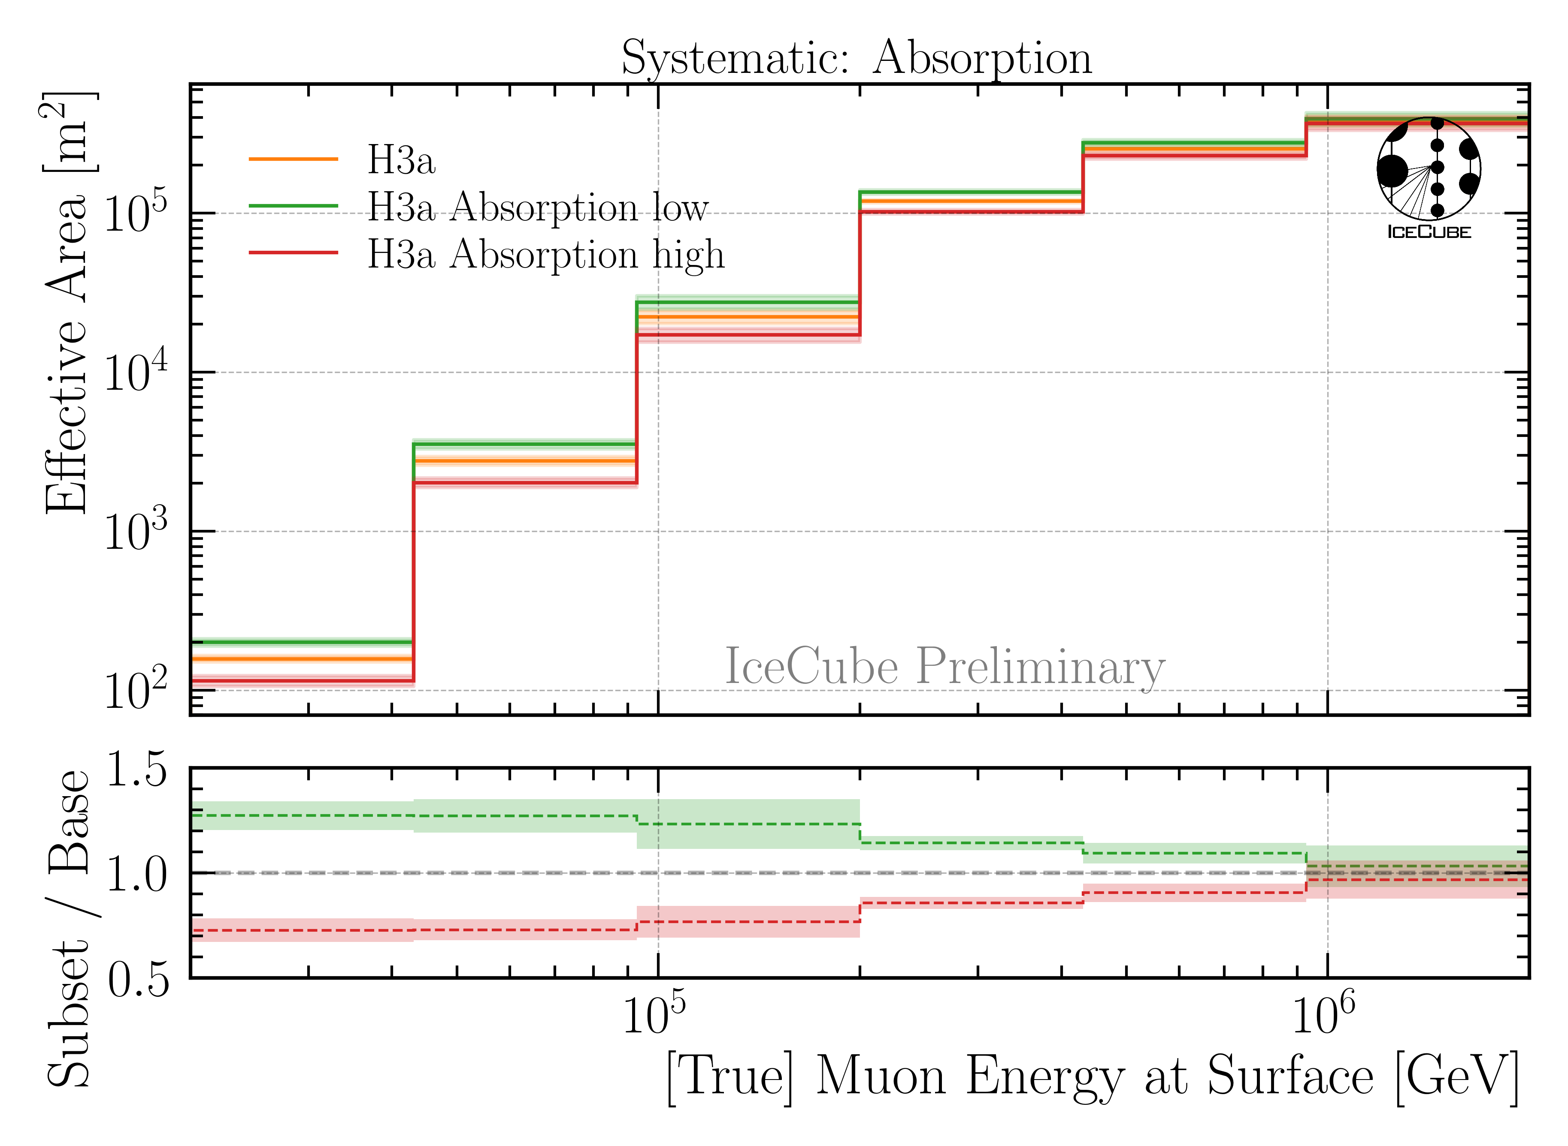
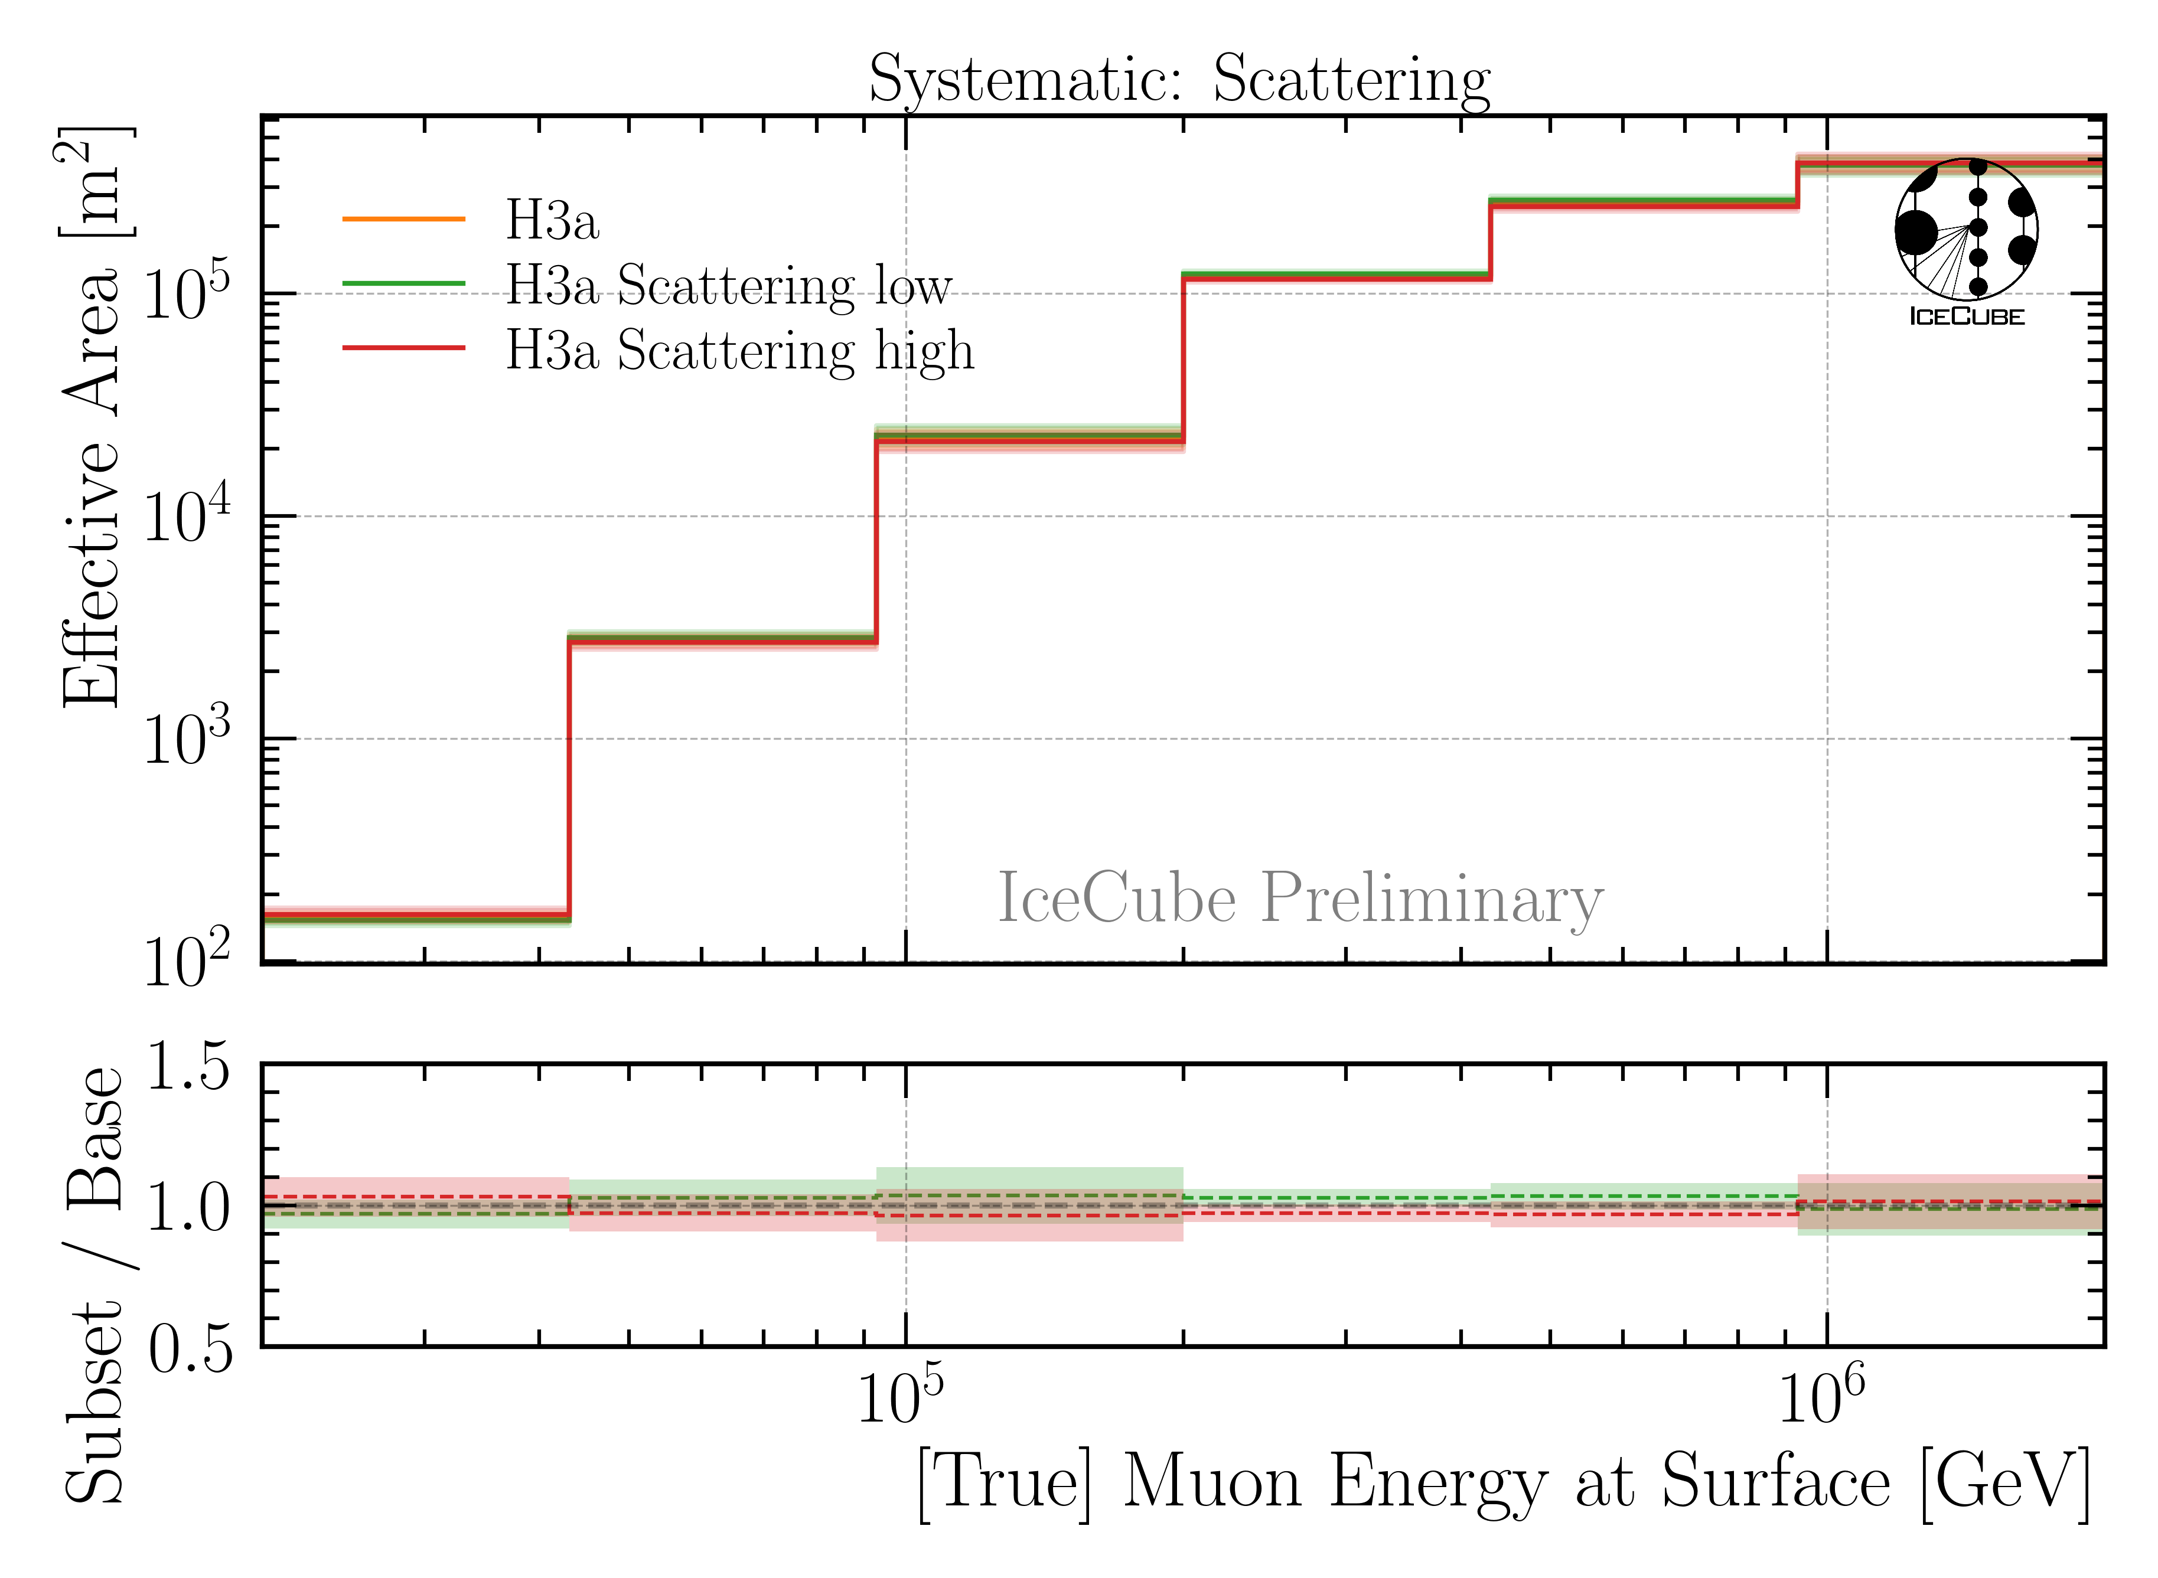
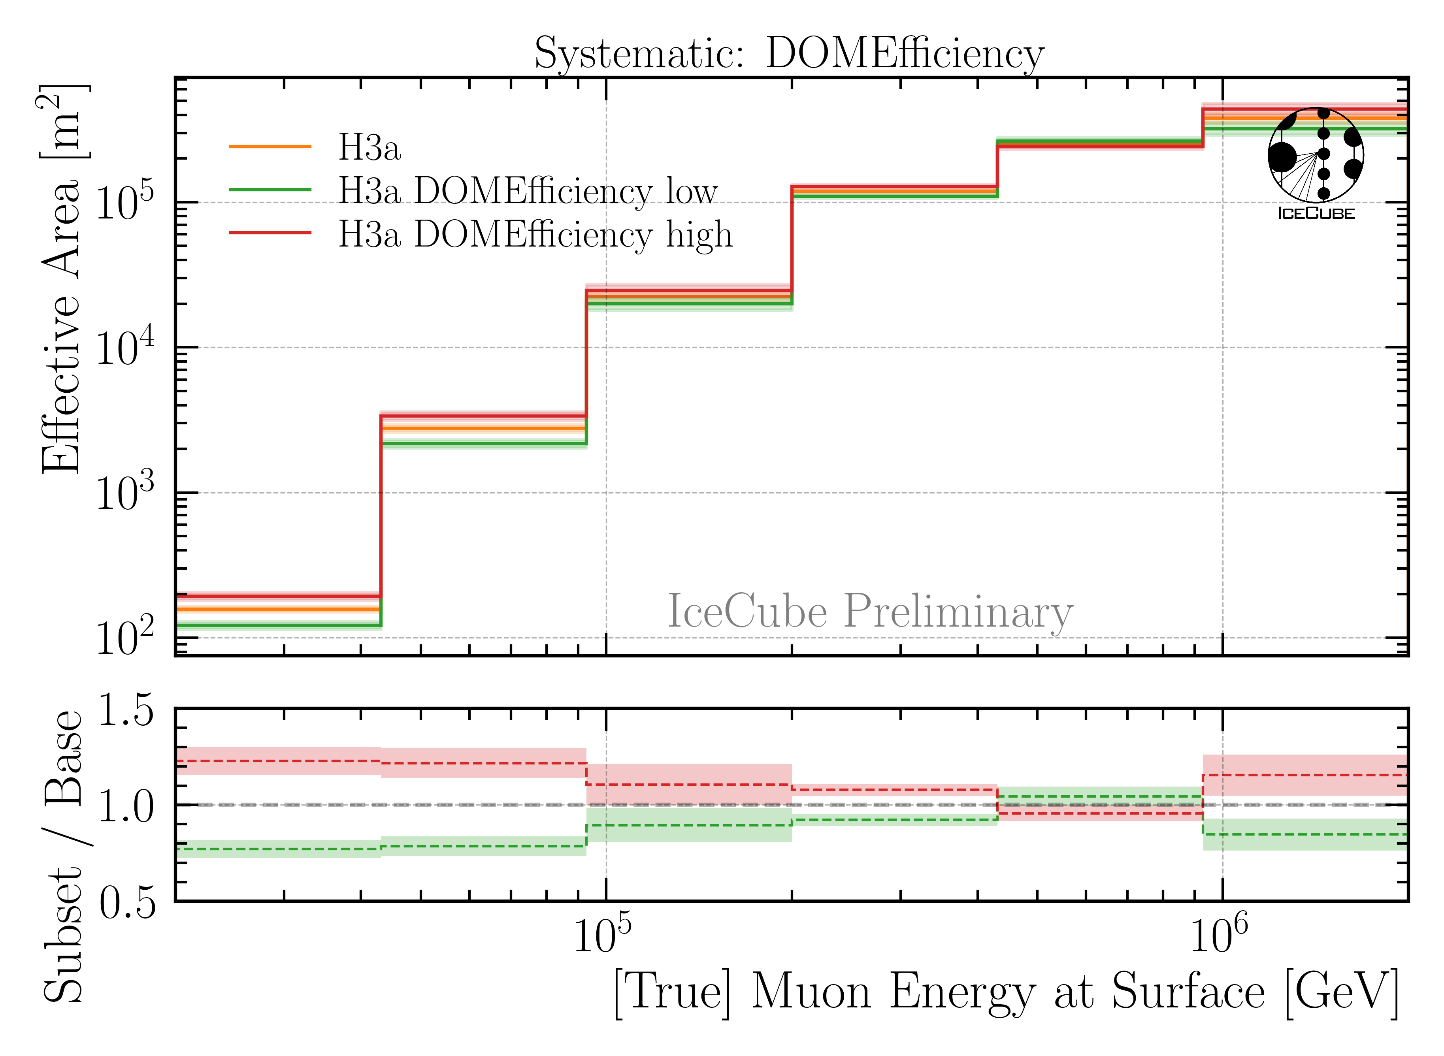
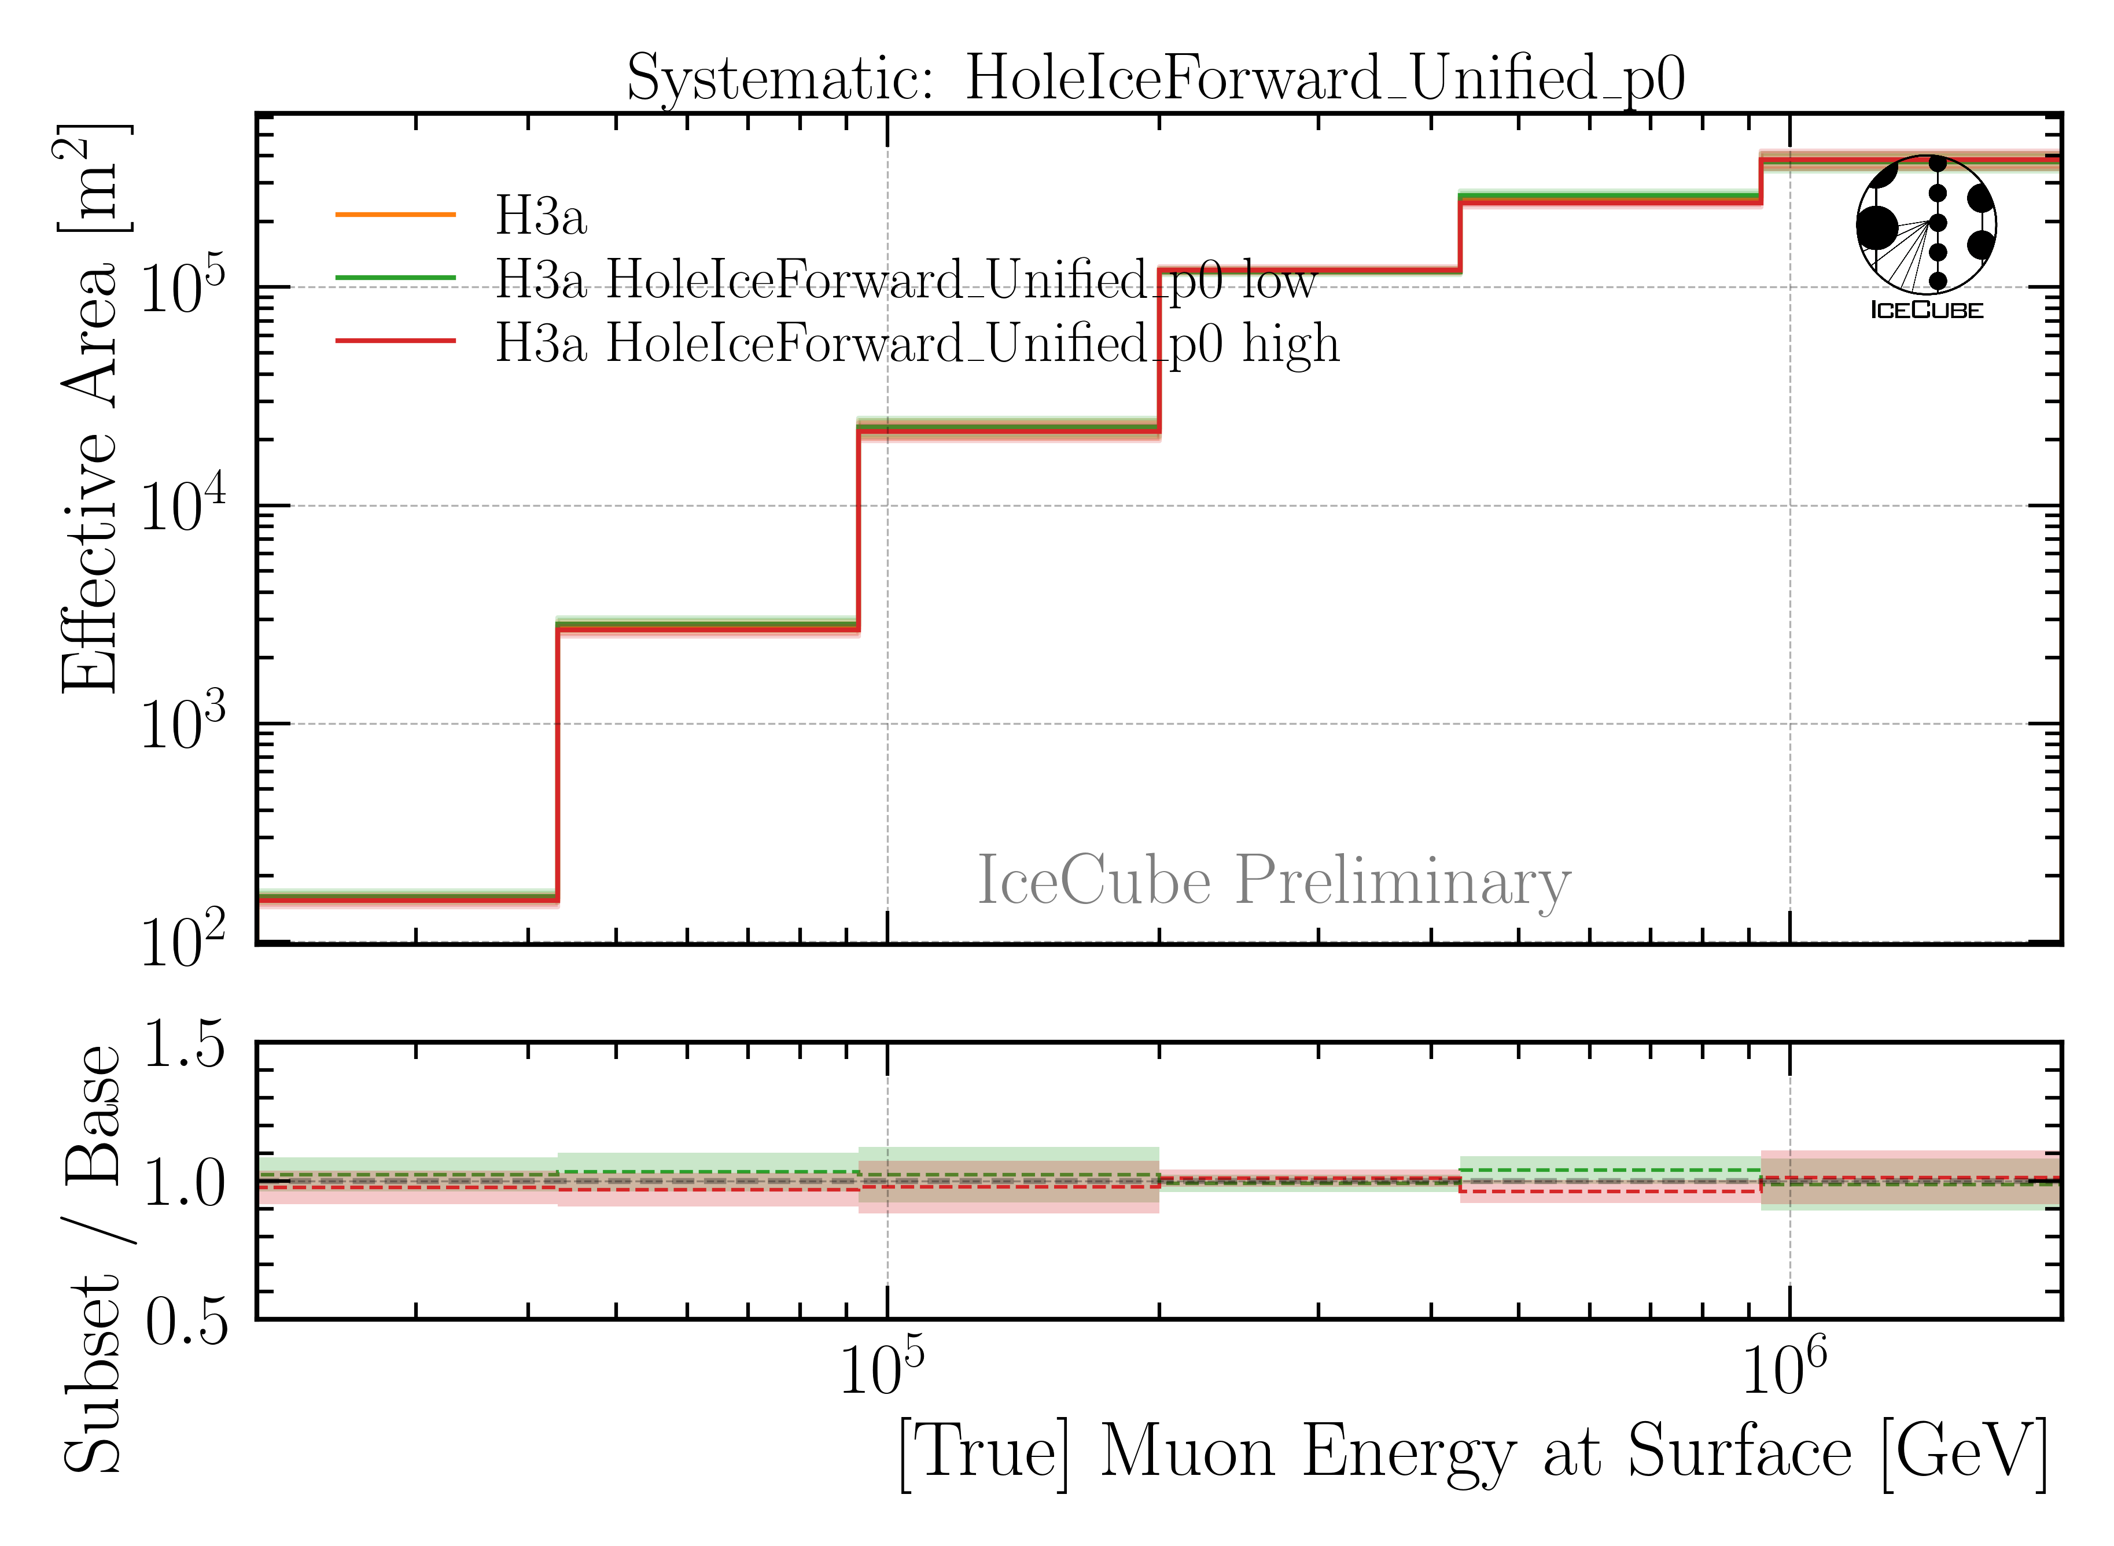
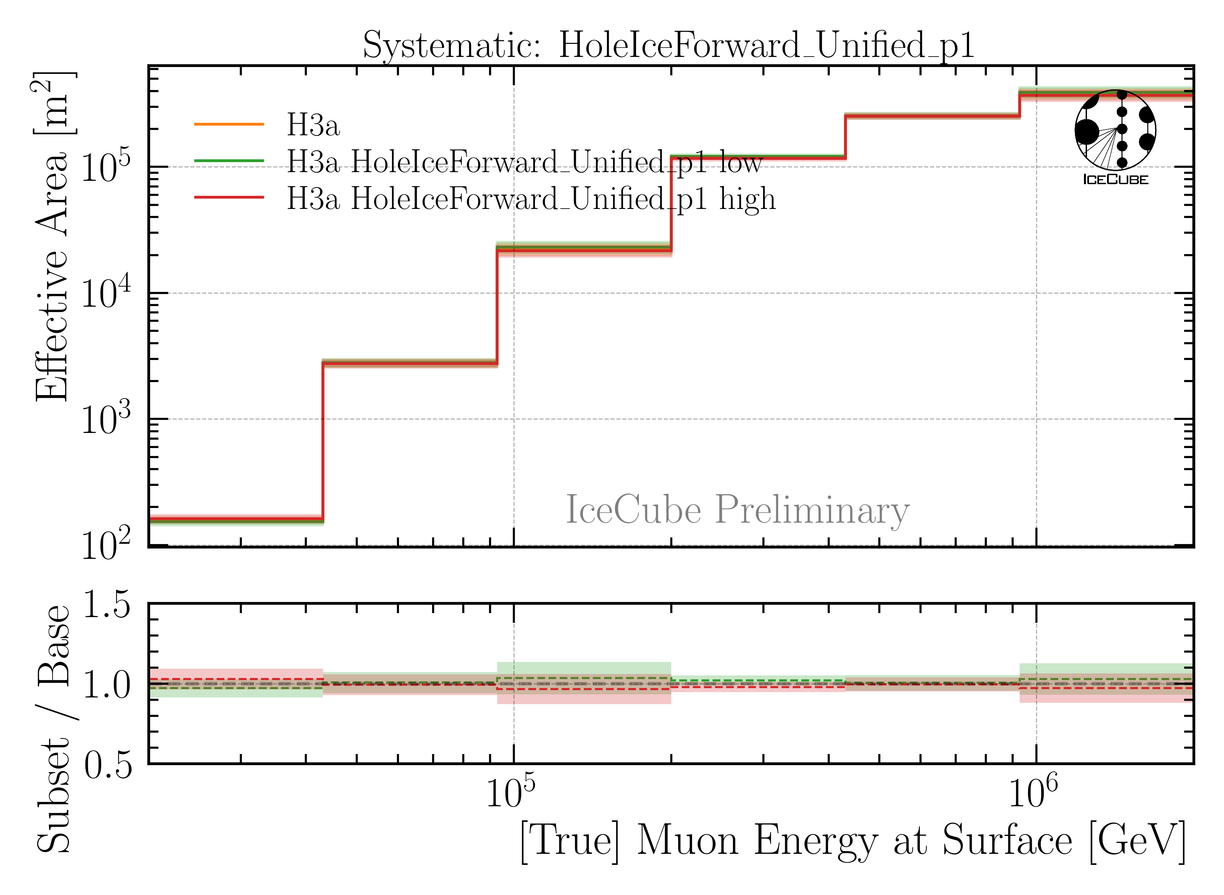
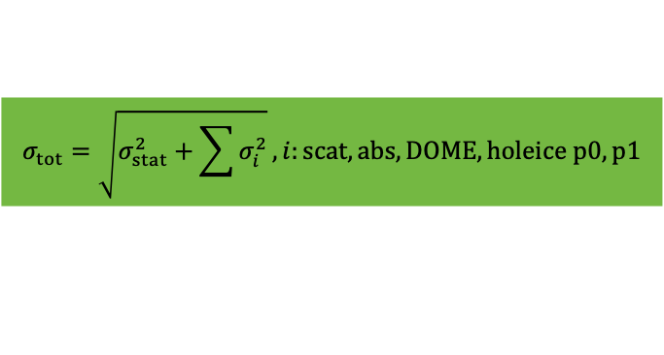
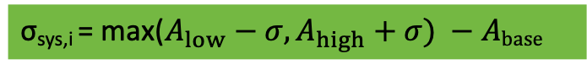
Ice & Detector Systematics
σ_{sys,i} = max($A_{low}−σ, A_{high}+σ) −Abase$
$$σ_{tot}=\sqrt{σ_{stat}^{2}+\sum{σ_{i}^{2}}}, i:scat, abs, DOME, holeice p0, p1$$
Baseline: entire set
Subset: above/below center

Slide 27
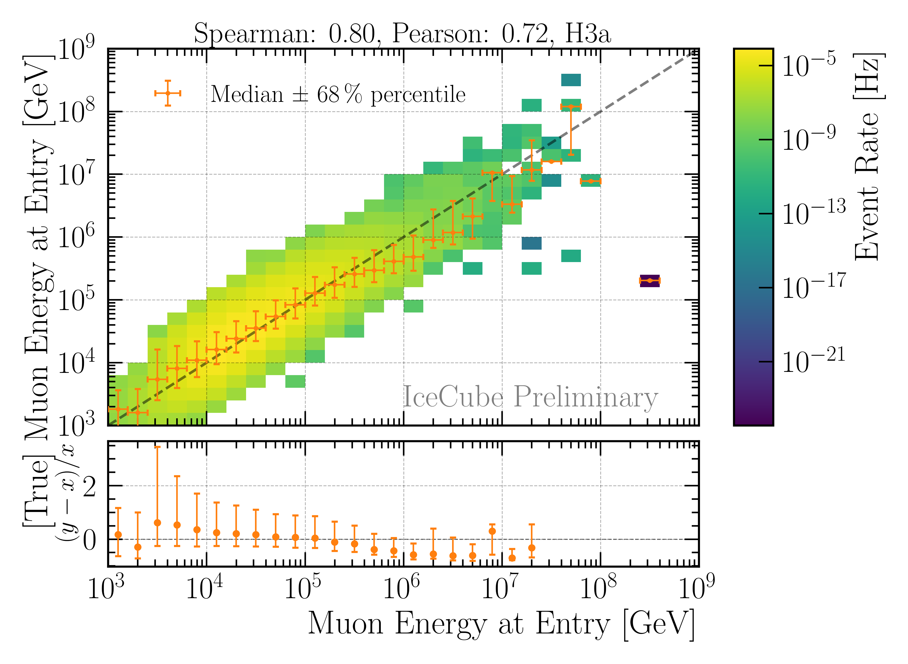
Reconstruction and Data—MC: Leading Muons
Good reconstruction of leading muon energy → proxy
Good data—MC agreement
Global offset → upscale MC by 12%

Slide 28
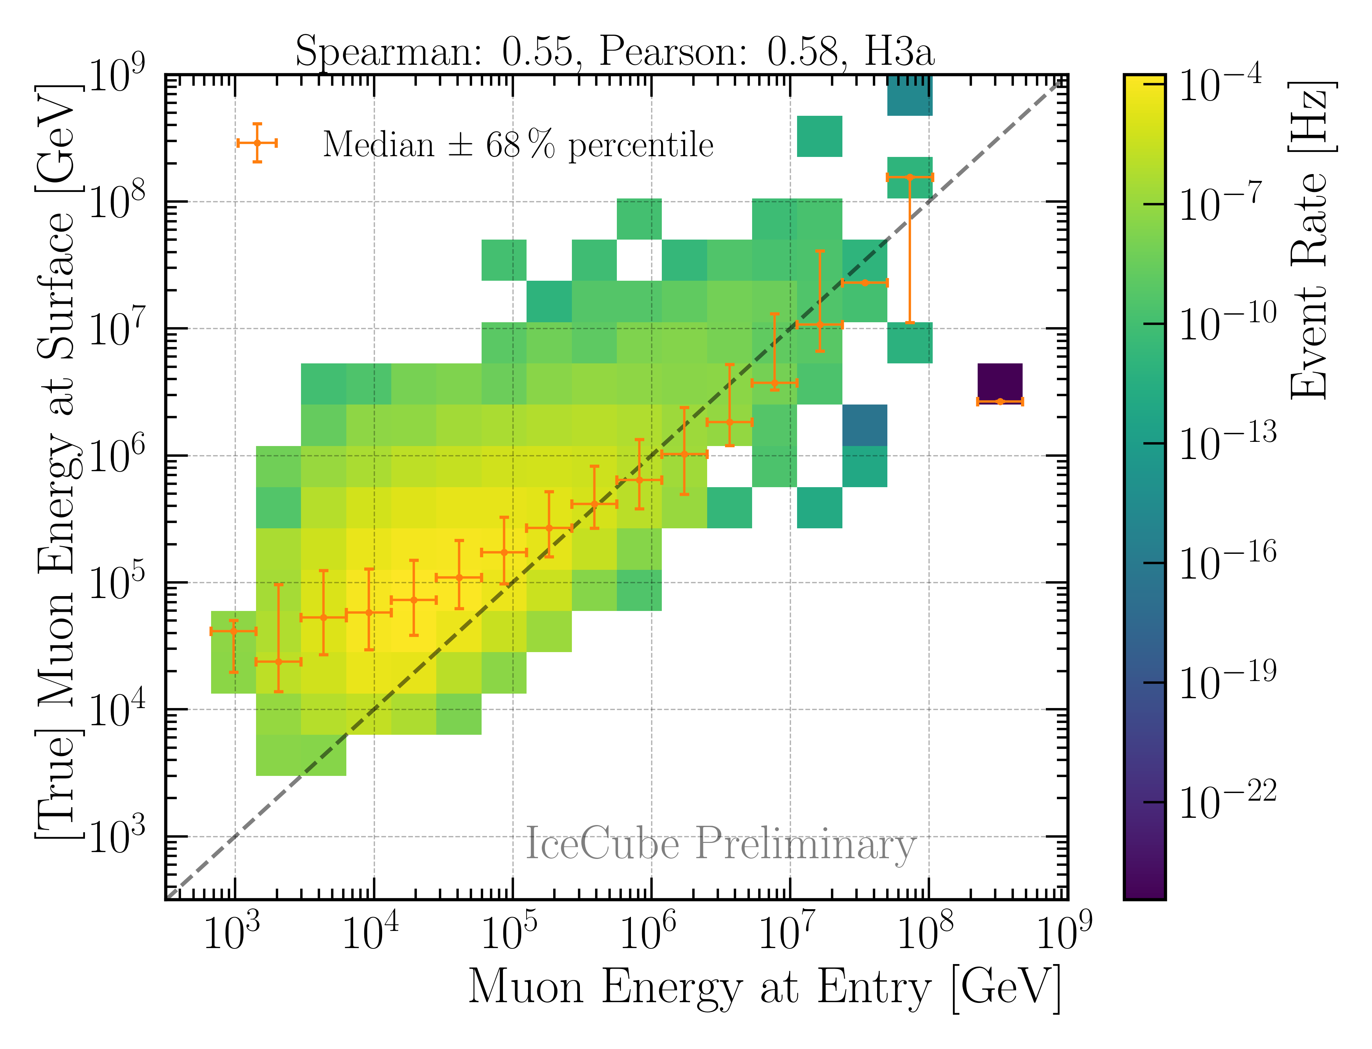
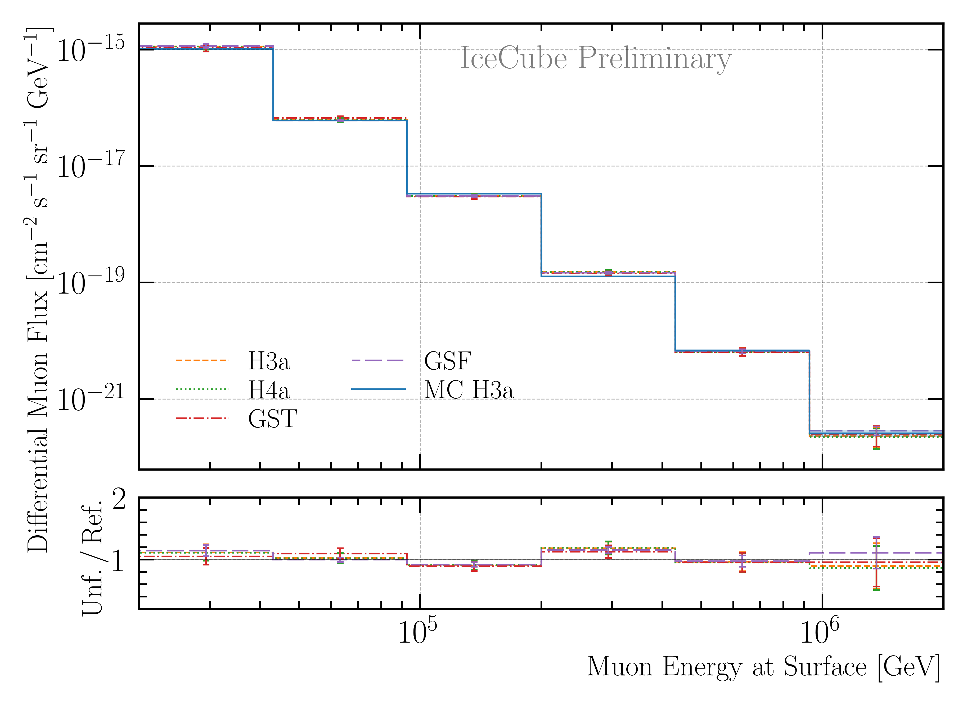
Correlation and Robustness Test: Leading Muons
Build unfolding matrix on H3a, H4a, GST & GSF
Unfold H3a as test set
Results are within uncertainties → robust
Correlation between proxy and target

Slide 29




Determine Regularization
Find regularization 𝜏 with minimal bin-to-bin correlation
LLH minimization (unfolding) provides full covariance matrix V
Minimize global correlation
$$ρ=\sum{V_{ij}}$$
$$i>j$$
Unfold MC truth → ratio should be 1

Slide 30

Muon Flux Unfolding
Leading muons
2487 h IceCube data
12754 events
Agrees with MCEq

Slide 31

Future: 12 Years of IceCube Data Unfolding
Finalize analysis
Proper systematic uncertainty estimation
Unfold 12 years of data
Extend energy range to >10 PeV
Characterize the atmospheric muon flux
Determine prompt component
MC only
Ratio to conv
Ratio to total
*no systematic uncertainties from effective area

Slide 32
Depth Intensity Unfolding
Utilizing stopping muons
by Lucas Witthaus

Slide 33


Reconstructions: Stopping Muons
Good reconstruction of stopping depth and zenith angle
Calculate propagation length → proxy variable for unfolding

Slide 34


Data—MC: Stopping Muons
Neutrino weighting:
SPL: n = 1.8, 𝛾 = 2.52
Good data—MC agreement
Global offset → upscale MC by 10%
IceCube Collaboration PoS ICRC2023 1064

Slide 35


Correlation and Robustness Test: Stopping Muons
Build unfolding matrix on H3a, H4a, GST & GSF
Unfold H3a as test set
Results are within uncertainties → robust
Strong correlation between proxy and target

Slide 36

Depth Intensity Unfolding
47 min IceCube data
32943 events
Comparison to MUTE¹
Up to 25 % below prediction at 2.5 – 5.5 km.w.e.
Mismodelling in energy losses?
¹W. Woodley et al. Phys. Rev. D 110 no. 6, (2024) 063006

Slide 37
Muon Flux
Stopping and Leading muons

Slide 38

Muon Flux Unfolding
Leading muons
2487 h IceCube data
12754 events
Agrees with MCEq
Stopping muons
47 min IceCube data
32943 events
Below MCEq prediction
*Stopping muon analysis done by Lucas Witthaus

Slide 39
Conclusion & Outlook
DNN-based reconstructions performed
Stopping muon selection
Leading muon selection
Good Data—MC agreement
Depth intensity unfolded using 47 min of IceCube data
Undershoots MUTE prediction up to 5.5 km.w.e.
Muon flux at surface unfolded using stopping muons and 2487 h of leading muon IceCube data
Flux undershoots up to 10 TeV (MCEq prediction) – stopping muons
Flux agrees from 20 TeV to 2 PeV with MCEq – leading muons
Slope increases towards higher energies
Prompt and conventional flux contributes similar to the flux at ~2 PeV
Finalize both analyses → unfold with more data
Extend energy range up to ~10 PeV
Thank you for your attention!

Slide 40
Backup

Slide 41


Bundle Energy Reconstruction
Level 4
Level 5
IceCube Preliminary
IceCube Preliminary

Slide 42


Muon Filter

Slide 43


Correlation and Robustness Test: Stopping Muons
Build unfolding matrix on H3a, H4a, GST & GSF
Unfold H3a as test set
Results are within uncertainties → robust
Correlation between proxy and target

Slide 44

Cosmic ray flux
Arxiv: 1903.07713
Notes:
1. Knee: ~3 PeV, before gamma = 2.7, limit of acceleration mechanism for cosmic rays in supernova remnants 2. Knee: ~100 PeV, before gamma = 3.1, heavier elements, like iron, from galactic sources start to reach their maximum acceleration energy → more protons, larger energy in electromagnetic acceleration Ankle: ~1 EeV, flattens out again, transition point between galactic and extra galactic particle origin,

Slide 45




Air shower – 10 TeV
Ralph Engel 2005
“muon bundles”
2211.16970v2
Proton
www.iap.kit.edu/corsika
Iron
Notes:
shower maximum: x_max, slant depth at which the number of particles is the greatest, more energetic and lighter cosmic rays produce deeper/lower x_max, while heavier nuclei have a higher shower maximum
measure number of particles / muons
lateral spread
nitrogen can be excited → fluorescence light emitted
iron produces more muons than proton, because it has 56 nucleons → higher fragmentation → “sub-showers”

Slide 46

Prompt atmospheric muons and neutrinos
10.1103/PhysRevD.100.103018
no unflavored
dominated by pions
dominated by kaons
Combined fit:
handle on pion/kaon ratio
handle on charmed mesons

Slide 47




Muon puzzle and model uncertainties
”muon number”
Expected z
(“muon number”)
2012
2108.08341
1208.1520
Uncertainties at E > 10 PeV
2020
More muons measured than simulated for E > 40 PeV ~ cms 8 TeV
2006.05012

Slide 48
CORSIKA 7 tagging and MCEq comparison
MCEq: tool to numerically solve the cascade equations that describes the evolution of particle densities as they propagate through a gaseous, dense medium
https://github.com/mceq-project/MCEq
GSF weighting
GSF weighting
Good agreement in total prompt and conv muon flux
D⁰ and D_{s} are swapped here but this is fixed in MCEq
mention panama

Slide 49

Machine Learning Reconstructions
10.1088/1748-0221/16/07/P07041
Credit: IceCube
Convolutional Neural Network
Inputs
c_{total}: Total charge
Sum of charge
t_{first}: Relative time of first pulse
Relative to total time offset
t_{std}: Standard deviation of first pulse
Charge weighted standard deviation of pulse times
Outputs
Direction
Stopping point
Entry point
Energy at entry/surface
…
Credit: IceCube

Slide 50
Level5: quality cuts
containment cuts | > | <
length in detector | 1000 m | 2000 m
entry pos x, y | -750 m | 750 m
entry pos z | -500 m | 750 m
center pos x, y | -550 m | 550 m
center pos z | -650 m | 650 m
uncertainty cuts | <
bundle energy at entry | 0.9 log10(GeV)
bundle energy at surface | 2.0 log10(GeV)
zenith | 0.1 rad
azimuth | 0.2 rad
entry pos x , y, z | 42 m
center pos x, y, z | 50 m
entry pos time | 200 ns
center pos time | 600 ns
length in detector | 160 m
length | 2000 m
neutrino cuts | > | <
cos(zenith) | 0.2
length | 5000 m | 15000 m

Slide 51

The Muon Puzzle
”muon number”
Arxiv: 2108.08341

Slide 52

Possible Solutions
Slide taken from Hans Dembinski

Slide 53

MCEq vs CORSIKA

